Slide 1
From Surviving to Thriving: Study Strategies for Active learning
Cody Harrison
Director of Academic Support

Slide 2
Today
Goal: provide you with strategies you can start using today
This is a general overview
Next presentation: August 16th
Study Skills Part II
Test Taking Strategies

Slide 3
Let’s test your knowledge
Kahoot!
Go to kahoot.it on your phone or laptop (or use the app if you have it)
Add the pin number that comes up on the next page.
Add a nickname (appropriate, please…we’re professionals!)
You’ll see questions with two answers. Choose the correct one!

Slide 4
What was that about?
How often do we use Google? Get Starbucks? Tweet? Share our lives on Instagram?
Once a week? Once a day? Multiple times an hour?
Yet…we didn’t answer all of the questions correctly.
Why?

Slide 5
Fluency Illusion
You see these logos all the time, but that doesn’t mean you know them
Apply this concept to your studies
Just looking at/re-reading PowerPoints or textbooks isn’t enough for knowledge

Slide 6
Memorize these words
Octopus
Baseball Team
Bowling Pins
Football Team
Eggs
Unlucky Floor
Valentine’s Day
Quarter Hour
Dollar Bill
Dice
Tricycle
Four-Leaf Clover
Hand
Six Pack
Seven Up

Slide 7
Active learning
How many did you get?
How could you have gotten more?

Slide 8
Memorize these words
Octopus
Baseball Team
Bowling Pins
Football Team
Eggs
Unlucky Floor
Valentine’s Day
Quarter Hour
Dollar Bill
Dice
Tricycle
Four-Leaf Clover
Hand
Six Pack
Seven Up

Slide 9
Active learning
Integrate new content with what you already know
Recognize patterns

Slide 10
Before class
Preview
Don’t be surprised – but don’t think you know everything
Get a “big picture” perspective

Slide 11
During class
Actively listen, don’t just sit and stare
Take notes not novels
Monitor your engagement
Ask questions

Slide 12
After class
Within 24 hours:
Review and summarize
Note what’s still confusing
Put major concepts into your own words

Slide 13
Active Studying
Spaced Practice – Space your studying out over time; cramming doesn’t work
Retrieval Practice – Study without your notes/materials; try to bring information forward without looking
Elaboration – Explain things with as many details as possible
Interleaving – Weave other information in while you’re studying; switch between subjects
Concrete Examples – Don’t be abstract; relate to lab, videos, your own life.
Dual Coding – Utilize visuals and words, not just one or the other.

Slide 14
Group study
Start it early and engage in it often
Share talents
Keep it small
Recognize when it changes from academic to just friends and fun

Slide 15
Time management

Slide 16
Schedule
It is necessary to roughly plan your schedule
Consider your preferences

Slide 17
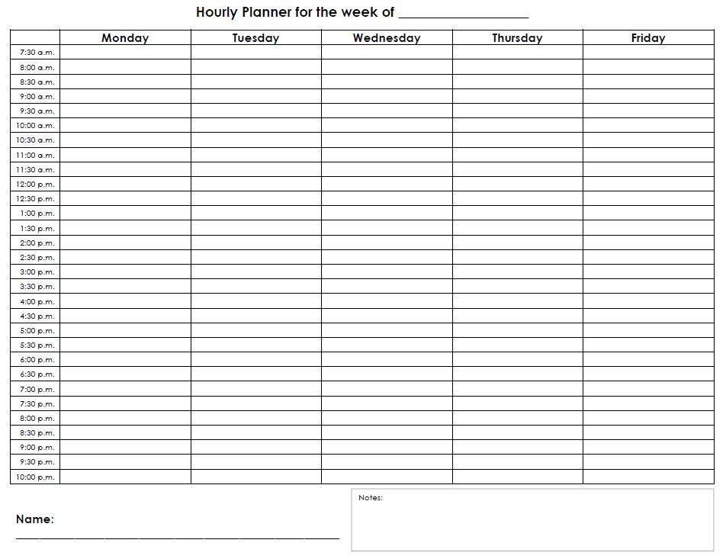
Sample Weekly Schedule

Slide 18
Sample weekly schedule
Date | 5/5/17 | 5/6/17 | 5/7/17 | 5/8/17 | 5/9/17
Morning (7am-8am)
Lunch
Afternoon (4pm-6pm)
Break (exercise/dinner)
Evening (8pm-9pm)
Study guide review
Week 2
Date

Slide 19
Sample Daily Schedule
Thursday 8/9
Condense notes from today’s Anatomy lecture
Test self with 20 MFMI flashcards
Spend 1.5 hours in Anatomy lab
Call home
Go to gym (45 minutes)

Slide 20
Time management
Be strict AND flexible
Be realistic
Set goals with time limits
Prioritize
Need to / Like to / Would be nice
Take advantage of down time

Slide 21
Remember
Self-Care is SEXY
Sleep
Eat
Xersize
You come first

Slide 22
Questions/comments?
http://www.tinyurl.com/AcademicSupportKnox
christopher.harrison@lmunet.edu
865-338-5705
Room 143

Slide 23
References/Resources
Augustin, M. (2014). How to learn effectively in medical school: Test yourself, learn actively, and repeat in intervals. Yale Journal of Biology and Medicine, 87, 207-212.
Dunlosky, J., Rawson, K.A., Marsh, E.J., Nathan, M.J., & Willingham, D.T. (2013). Improving students’ learning with effective learning techniques: Promising directions from cognitive and educational psychology. Psychological Science in the Public Interest, 14(1), 4-58.
Karpicke, J. D. (2012). Retrieval Based Learning: Active Retrieval Promotes Meaningful Learning. Current Directions in Psychological Science, 21 (3), 157-163.
Kelman, E.G. & Straker, K.C. (2000). Study without stress: Mastering medical sciences. Thousand Oaks, CA: Sage Publications, Inc.
Nyland, R. & Sawaryinksi, K. (2014). Purging the binge and purge: An interactive study skills workshop. Retrieved from https://www.mededportal.org/icollaborative/resource/3804
Ulrich, U. (2017). Learn better: Mastering the skills for success in life, business, and school, or, how to become an expert in just about anything. New York, NY: Rodale Books.
Willingham, D.T. (2010). Why don’t students like school? San Francisco, CA: Jossey-Bass.

