Slide 1
Get active – stay active
Why active studying matters

Slide 2
Find the numbers in sequential order, starting with 1
How many can you find in 15 seconds?

Slide 5
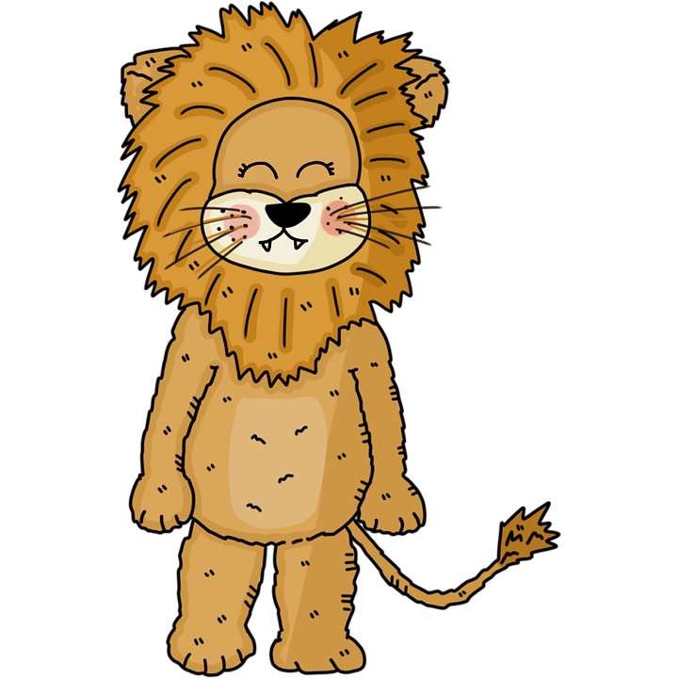
Let’s try something different.

Slide 6
Discuss the following questions with your neighbors:
How do you fit an elephant into a refrigerator?
How do you fit a giraffe into a refrigerator?
Story time: Simba wants to bring together the animal kingdom in the name of peace and being good neighbors. He calls a meeting, requiring all animals to be present. As the meeting begins, though, he realizes someone isn’t there. Who didn’t show?
You’ve decided to take up running while you’re in medical school. Good for you! During your final rotation, in Ocala, Florida, you come across a downed bridge along your normal running route. You want to cross, but you’re worried about the gators in the river. How do you get across?

Slide 7
What do these things have to do with anything, Cody?

Slide 8
Use Metacognition to become an Expert Learner

Slide 9
METACOGNITION The ability to: - Think about thinking - Be consciously aware you’re a problem solver - Monitor and control your mental processing - Be aware of the type of learning you’re doing

Slide 10
What do you need to do? - Stay in LEARN mode, not STUDY mode -Study like you’re teaching the material, not just for an A

Slide 11
Become an expert learner: - Ask “why” and “what if” questions - Test your understanding by verbalizing/writing concepts out - Find new pathways to information

Slide 12
That all sounds great…but how?

Slide 13
The Study Cycle
Preview
Attend
Review
Study
Assess
Before class, skim textbooks, PowerPoints, lecture notes, summaries, and objectives. Come up with questions you’d like the lecture to answer for you.
Before class, skim textbooks, PowerPoints, lecture notes, summaries, and objectives. Come up with questions you’d like the lecture to answer for you.
Before class, skim textbooks, PowerPoints, lecture notes, summaries, and objectives. Come up with questions you’d like the lecture to answer for you.
Attend class! If not live, watch Mediasite. Answer questions, ask/create your own questions, and take meaningful notes. Keep it active!
After class, within 24 hours, read your notes, fill in any gaps, and make a note of any questions you still have.
After class, within 24 hours, read your notes, fill in any gaps, and make a note of any questions you still have.
After class, within 24 hours, read your notes, fill in any gaps, and make a note of any questions you still have.
Ask “why?”, “how?”, and “what if?”. Keep it active with practice questions, flashcards (Anki!), study guides, group study, and Focused Study Sessions.
Ask “why?”, “how?”, and “what if?”. Keep it active with practice questions, flashcards (Anki!), study guides, group study, and Focused Study Sessions.
Periodically perform reality checks: “Am I using study methods that are effective?” “Do I know the material enough to teach it to others?”
Periodically perform reality checks: “Am I using study methods that are effective?” “Do I know the material enough to teach it to others?”

Slide 14
Focused Study Sessions
Steps | Description
1. Set a goal (1-2 min) | Write down, specifically, what you’re going to study/accomplish during this session
2. Study with focus (30 – 50 min) | Be Active - Use Anki, rewrite your notes in different words, summarize, create test questions, etc.
3. Reward Yourself (5 - 10 min) | Walk away, check your phone, get a snack, stretch, move your laundry over, etc.
4. Review/Recall (5 min) | Try to summarize everything you studied without looking at notes.

Slide 15
But how do I fit all of this in?!?

Slide 16
Time management is key

Slide 17
What, So What, Now What?
Notes:
Write down the following:
What is something you learned from this session?
Why is it important?
What are you going to do with the above information moving forward?

Slide 18
Questions, comments, concerns?

