Slide 1
Second Semester Study Review

Slide 2
Picture This
Notes:
Close your eyes and think about last semester. Think about differences between day one of lectures and cumulative exam. What changed personally? Academically? Socially? Think of the semester as a whole and how you felt internally and externally as the semester progressed.
What are you telling yourself?
What are you visualizing?
Open your eyes.

Slide 3
Reflection
What did you just tell yourself?
What did you visualize?
Notes:
Some of you may have thought: “Wow, I did great! Can I keep it up?” or “Whoa, that was tough; I wasn’t expecting my grades to look like this…” or “This wasn’t like anything I’ve ever done, am I even fit for this?”

Slide 4
Fixed vs. Growth
A fixed mindset would say things like:
Med school is tough, it’s not just me.
Others did better than me, but they had better preparation. I’m still a contender.
But am I? Who am I fooling, I’m not going to be a doctor. I had to study harder and longer than everyone else and still didn’t do as well as I thought I should.
Look at them! They barely study and get an A on everything. I’ll never be that.
Notes:
Eventually you’ll talk yourself back into the idea that it’s just hard, the questions on exams weren’t the best, etc.
But that’s where it ends.
All you’ve done is talk to yourself. You haven’t made plans to improve.

Slide 5
Fixed vs. Growth
A growth mindset would say things like:
Med school is tough, it’s not just me.
Others did better than me, but they had better preparation. I’m still a contender.
But am I? Who am I fooling, I’m not going to be a doctor. I had to study harder and longer than everyone else and still didn’t do as well as I thought I should.
Look at them! They barely study and get As on everything. I’ll never be that.
But then…
You’ll ask yourself, what could I do differently? What needs to change?
Notes:
Initially stating the negative may still happen. It can be a natural response. But it’s what you do afterward that reflects a change to growth mindset.
Growth mindset talks about focusing on what you can do and what you’re going to do to improve to where you know you can be.

Slide 6
Growth Mindset – How Can I Get There?
Set Goals!
Be Vivid!
Visualize the when, where, and how.
Tomorrow morning, after I shower, eat, and brush my teeth, I am going to preview for Monday’s Physio lecture for 45 minutes. Then I’ll take a break and text my friend about our dinner plans. Then I will close my door, sit down at my laptop, and do 3 sets of Anki cards for MFM II, Physio, and MGA (just to review).
Phrases like “I’ll do it tomorrow” or other vows are fixed and don’t work.

Slide 7
Growth Mindset – How Can I Stay There?
Ask yourself:
What are the opportunities for learning and growth today? For myself? For those around me?
When, where, and how will I embark on my plan?
What do I have to do to maintain and continue my growth?

Slide 8
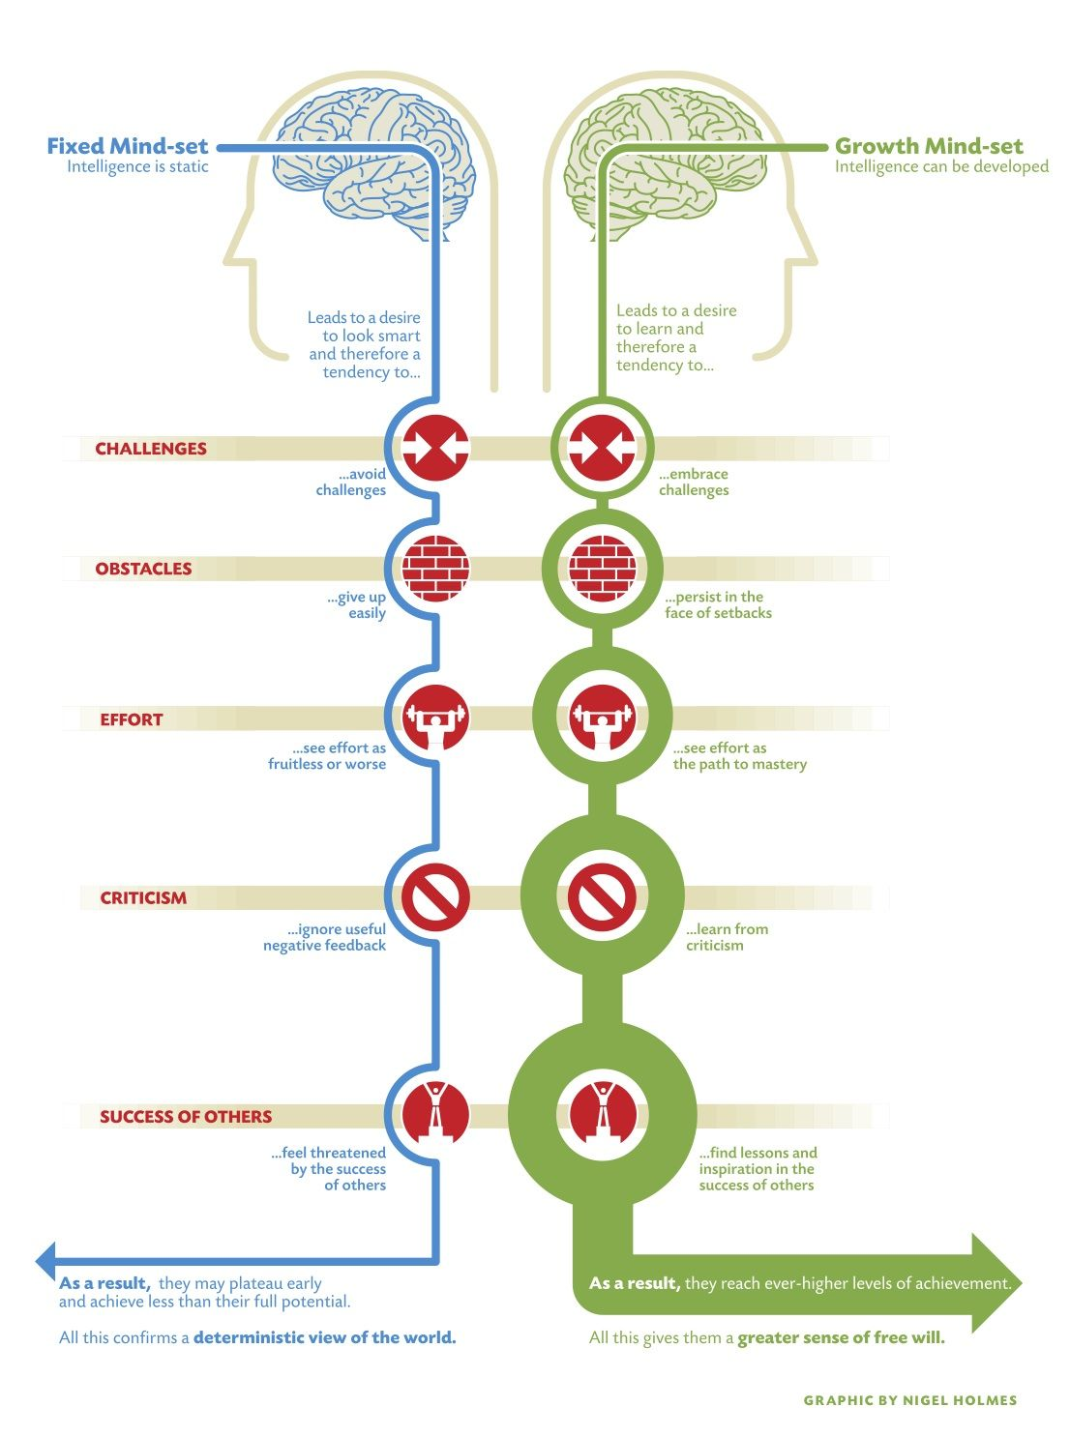
Dweck, C. S. (2016). Mindset: the new psychology of success. New York: Ballantine Books.

Slide 9
Studying - Let’s dive a little deeper

Slide 10
Fluency Illusion
Misjudging the depth of what you know.
The belief that because facts and formulas are easy to remember right now, they’ll remain that way tomorrow and the next day.
You feel like you’ve nailed some topic and assume further study won’t help.
Notes:
We talked about this some last semester, but what is it?
Now that you’ve finished a semester, you may think “wow, I know this stuff!” or “I had microbiology already, immuno will be easy” or “I watched mediasite and looked at the PowerPoint once and it all made sense, I’m good to go!”

Slide 11
Fluency Illusion Example
You attend Dr. Gregg’s first few lectures and it sounds very familiar. Almost exactly the same at the couple lectures you had in your undergrad micro course. You think, “I’m golden! This will be a piece of cake; I’ll just put all my focus on physio instead.” – Fast forward to the first exam…

Slide 12
Active Studying – A Review
Spaced Practice – Space your studying out over time; cramming doesn’t work
Retrieval Practice – Study without your notes/materials; try to bring information forward without looking
Elaboration – Explain things with as many details as possible
Interleaving – Weave other information in while you’re studying; switch between subjects
Concrete Examples – Don’t be abstract; relate to lab, videos, your own life.
Dual Coding – Utilize visuals and words, not just one or the other.

Slide 13
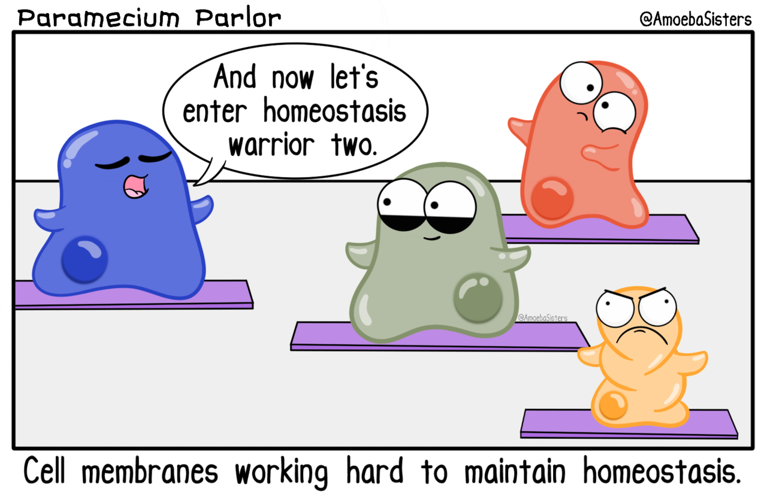
Physiology
Focus on details and cause/effect/compensation
Studying for classmates – studying for cody
Read the textbook
Pay attention to flow diagrams and graphs – draw them
Know physio to know pharm
Listen to your instructors

Slide 14
mfmii
micro
Color code your bacteria – purple = gram + pink = gram –
Know your media and vaccines
Group based on what things cause
Immuno
Lectures are structured to cover 3-4 concepts – read through the concepts before the lecture
Do the practice questions
Keep up! – Immuno is taught at a fast pace over a short time
Diagram and draw

Slide 15
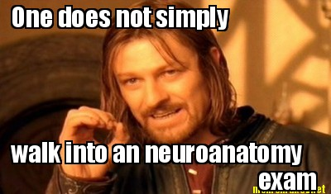
Neuroanatomy
Is there a diagram? Know how to draw it! It only takes 30 seconds to draw it on your scratch paper
Read your textbook – they’re short chapters that are clinically oriented and many of the pictures will be replicated on the lecture powerpoints
Listen to your instructors – this is a very straight forward course

Slide 16
pharmacology
Categorize the drugs into groups
Focus on mechanism of action/uses/adverse effects/contraindications/drug interactions
This is not an easy course – it comes down to a lot of repetition and putting in the required work outside of class
Learn drug names from the beginning
Make connections between pharm and physio
Look for patterns, make up stories and pneumonic devices, use flashcards, etc.

Slide 17
Now what?
Remember your resources:
Meet with me - http://bit.ly/DCOMKacademicsupport (case sensitive)
MEET WITH YOUR ADVISOR
GO TO TUTORING (NEXT SLIDE)
IMMUNO REVIEW SESSIONS – SCHEDULE COMING SOON!
FIRST ONE IS TOMORROW – 3:15PM, LECTURE HALL 4

Slide 18
Spring 2020 Tutoring Schedule
Tutor | Zach | Brandon | Austin | Staci | Brianna | Prachi/Dan
Subject | Physio | Physio | Physio | Physio | MFMII* | MFMII*
Begin Date | 1/13 | 1/14 | 1/14 | 1/16 | 1/28 | 1/31
Days/Times | Mondays/Wednesdays 5:00-7:30pm | Tuesdays 5:30-7:30pm | Tuesdays/Thursdays 8:00-10:00pm | Thursdays 6:00-8:00pm | Tuesdays 5:00-7:00pm Fridays 6:00-8:00pm | Fridays 7:00-9:00pm
Location | Lecture Hall 4 | Zoom | Zoom | Zoom | Zoom | Zoom
**Immunology tutoring will be done via streamed sessions**
Things to remember
Find your tutor
Tutors are students too
You have other resources as well
Be professional
interact

Slide 19
Proof (and references)
Blair, R., Tolman, A. O., Kremling, J., & Morris, T. (2017). How promoting student metacognition can reduce resistance. In Why Students Resist Learning (pp. 165–188). Sterling, VA: Stylus Publishing, LLC.
Carey, B. (2015). How we learn: the surprising truth about when, where and why it happens. New York: Random House.
Dweck, C. S. (2016). Mindset: the new psychology of success. New York: Ballantine Books.
Yan, V. X., Bjork, E. L., & Bjork, R. A. (2016). On the difficulty of mending metacognitive illusions: A priori theories, fluency effects, and misattributions of the interleaving benefit. Journal of Experimental Psychology: General, 145(7), 918–933. doi: 10.1037/xge0000177

