Slide 1
Pharmacology

Slide 2
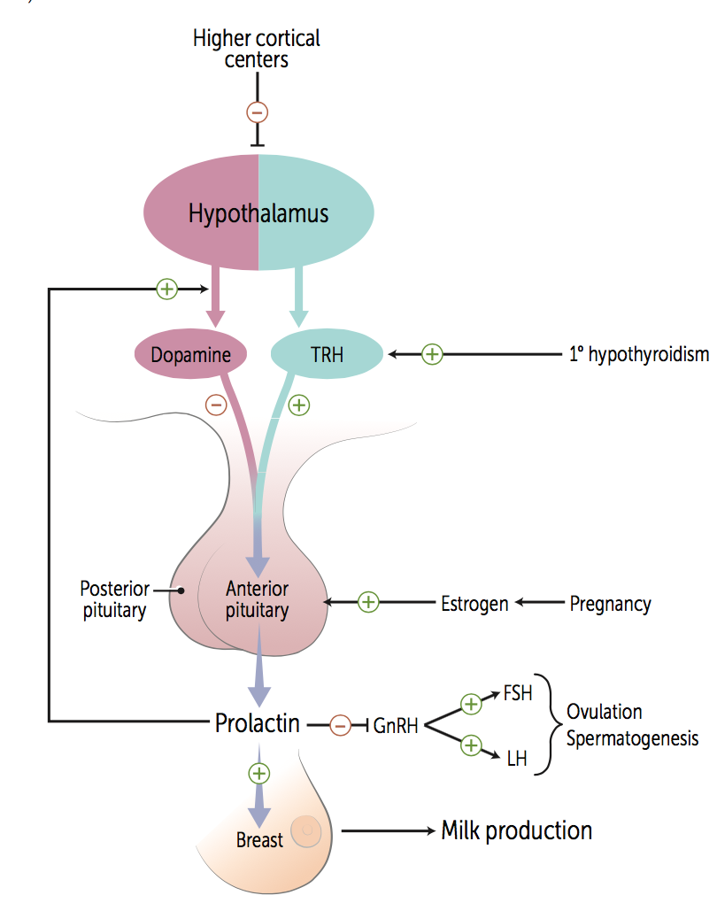
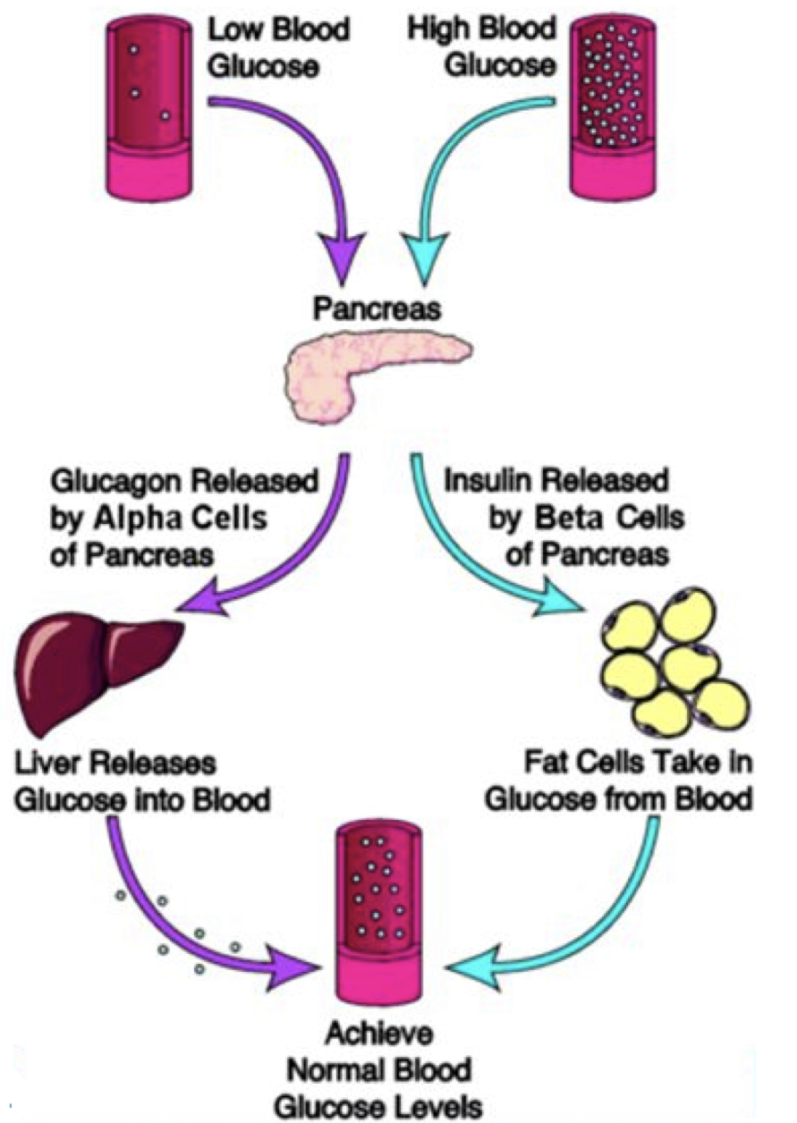
Growth Hormone
Prolactin
Agonists:
Somatropin– recombinant GH; used in children--dwarfism
AE: pseudotumor cerebri, slipped capital femoral epiphysis, scoliosis, edema, hyperglycemia
Mecasermin– recombinant IGF, GF insensitivity (Laron); deficient in IGF – adult
AE: hypoglycemia
Disease that interrupts the hypothalamus-pituitary portal systems – results in decreased secretion of anterior pituitary gland hormones & increased prolactin
Hyperprolactinemia suppresses the HPA axis and galactorrhea
D2 Agonists: Dopamine inhibits prolactin release
(GnIF)
(somatomedian)
Antagonists:
Somatostatin analogs– treats somatotropin adenomas
D2 Agonists– high dose: effective in small GH tumors
Pegvisomant– prevent receptor dimerization
Liver disease? Low IGF
Tx: mecasermin
Agonists: Somatropin, Mecasermin
Antagonist: Somatostatin (Octreotide, Lanreotide) , D2 Agonists (Bromocriptine), Pegvisomant
Bromocriptine, Cabergoline
Posterior Pituitary
Insulin
ADH agonist: secretion by hypothalamus and stored in posterior pituitary and released in response to increased serum osmolarity, decreased blood volume, decreased BP
ADH antagonist: promotes excretion of free water at V2 receptor (without electrolytes) resulting in net fluid loss, increased urine output, decreased urine osmolarity, and subsequent normalization of sodium
AE: hepatoxicity (tolvaptan)
Glucocorticoids decrease affinity of insulin receptors for insulin
Exogenous insulin– no c-peptide
Endogenous insulin– has c-peptide
ADH agonist: desmopressin, vasopressin
ADH antagonist: conivaptan, tolvaptan
Insulin
Notes:
Lecture 35: Intro to Endocrine

Slide 3
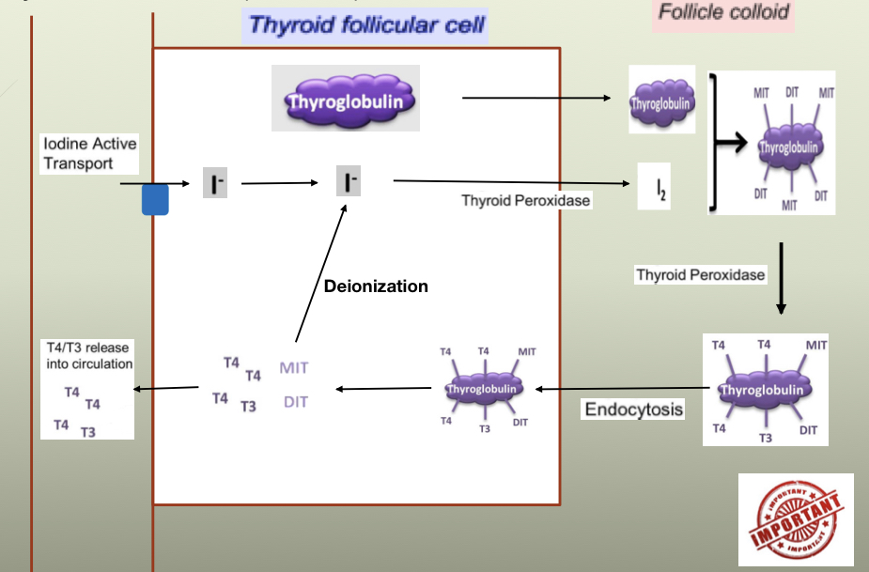
Hypothyroidism
Hyperthyroidism
Cold intolerance, fatigue, constipation, hair loss, weight gain
Heat intolerance, palpitations, insomnia, weight loss
Low T4, T3 and TSH (in primary or low in central)
Most commonly use Levothyroxine due to: cheap, long lasting but does have slow onset
Don’t give for weight loss: causes life threatening toxicities
Interactions with T4: adrenergics, cortisol (increased catabolism), Digoxin (increased Vd and renal clearance), insulin (hyperglycemia-–monitor serum glucose), warfarin (increased catabolism of clotting factors)
Thioamides: Inhibits TPO-catalyzed reactions and blocks iodine organification—prevents binding to I to tyrosine
PTU: inhibits TPO and converts T4 → T3, so brings down levels faster
CI: Methimazole: pregnancy; Propylthiouracil: higher risk of serious liver injury
AE: maculopapular rash, severe hepatitis, agranulocytosis– all rapidly reversible
Iodides: Blocks the release of T4 and T3 and inhibits iodine organification
Can be used preoperatively
Uses: must be given after thioamine to prevent iodine from being used, after radioactive iodine to normalize function, protect thyroid from radioactive iodine
Blocks for 2-8 weeks
Wolff-Chalkoff Effect
Radioactive iodine—treatment of thyrotoxicosis—incorp in storage follicles crosses placenta and excreted in breast milk
Thiocyanate and Perchorate—effectiveness is unpredictable
Others: inhibits peripheral conversion of T4 → T3
Beta adrenergic blockers: propranolol
Glucocorticoids
Amidodarone
Levothyroxine (T4), Liothyroxine (T3), Liotrix (4T4:1T3), Thyroid USP (Armor)
Radioactive iodine (131 I), Thioamides (Methimazole, Propylthiouracil), Iodides (Lugol’s Solution, Potassium iodide)
Notes:
Lecture 36: Thyroid and Glucocorticoids
Wolff-Chalkoff Effect—iodine overload combined with autoregulatory inhibiting iodine organification and formation of T3/4
Contrasted with non-autoregulation where increased iodine leads to thyrotoxicosis → Jod-Basedow Phenomenon

Slide 4
Corticosteroids
CRH Analog
ACTH Analog
AE:
Short-term:
Hyperglycemia
Infection
Decreased wound healing
Zona glomerulosa → salt
Zona fasciculata → sugar
Zona reticularis → sex
Medulla → Epi
Addison’s Disease: dizziness, NV, weight loss, ↑ K⁺
Primary adrenal insufficiency– adrenal cortex is destroyed
Secondary adrenal insufficiency-- ↓ ACTH--> aldosterone doesn’t change
tx: hydrocortisone
Prednisone– safe in pregnancy
Fludrocortisone– glucocorticoid + mineralocorticoid activity
Reabsorbs Na⁺ and lose K⁺ from DCT
Tx: hypoaldosteronism
Glucocorticoids– increase gluconeogenesis, protein catabolism and decrease insulin sensitivity, AB, inflammation, neoplasm
Secreted by hypothalamus
CRH stimulates ACTH
Long-term:
Osteoporosis
Addison’s crisis with withdrawal
Cushing’s: Fat redistribution
Prednisone, Prednisolone, Hydrocortisone, Dexamethasone, Fludrocortisone
Cortecorelin
Cortrosyn
Glucocorticoid Inhibitors
Aldosterone Antagonists
Cushing’s syndrome: moon face, cardiac hypertrophy/HTN, buffalo hump, obesity, abdominal striae, amenorrhea, muscle weakness, skin ulcers
Can be due to excess of cortisol meds or prednisone
Metyrapone– inhibits 11-B-hydroxylase
Ketoconazole– inhibits all adrenal hormones
Use: edema d/t increased aldosterone, primary aldosterone, CHF, hypokalemia
ADE: hyperkalemia, gynecomastia
Mineralocorticoid– aldosterone-- ↑Na⁺/H₂O retention, ↓ K⁺
Spironolactone– androgen receptor antagonist
Ketoconazole, metyrapone
Spironolactone, eplerenone
Notes:
Lecture 36: Thyroid and Glucocorticoids
↓ ↑

Slide 5
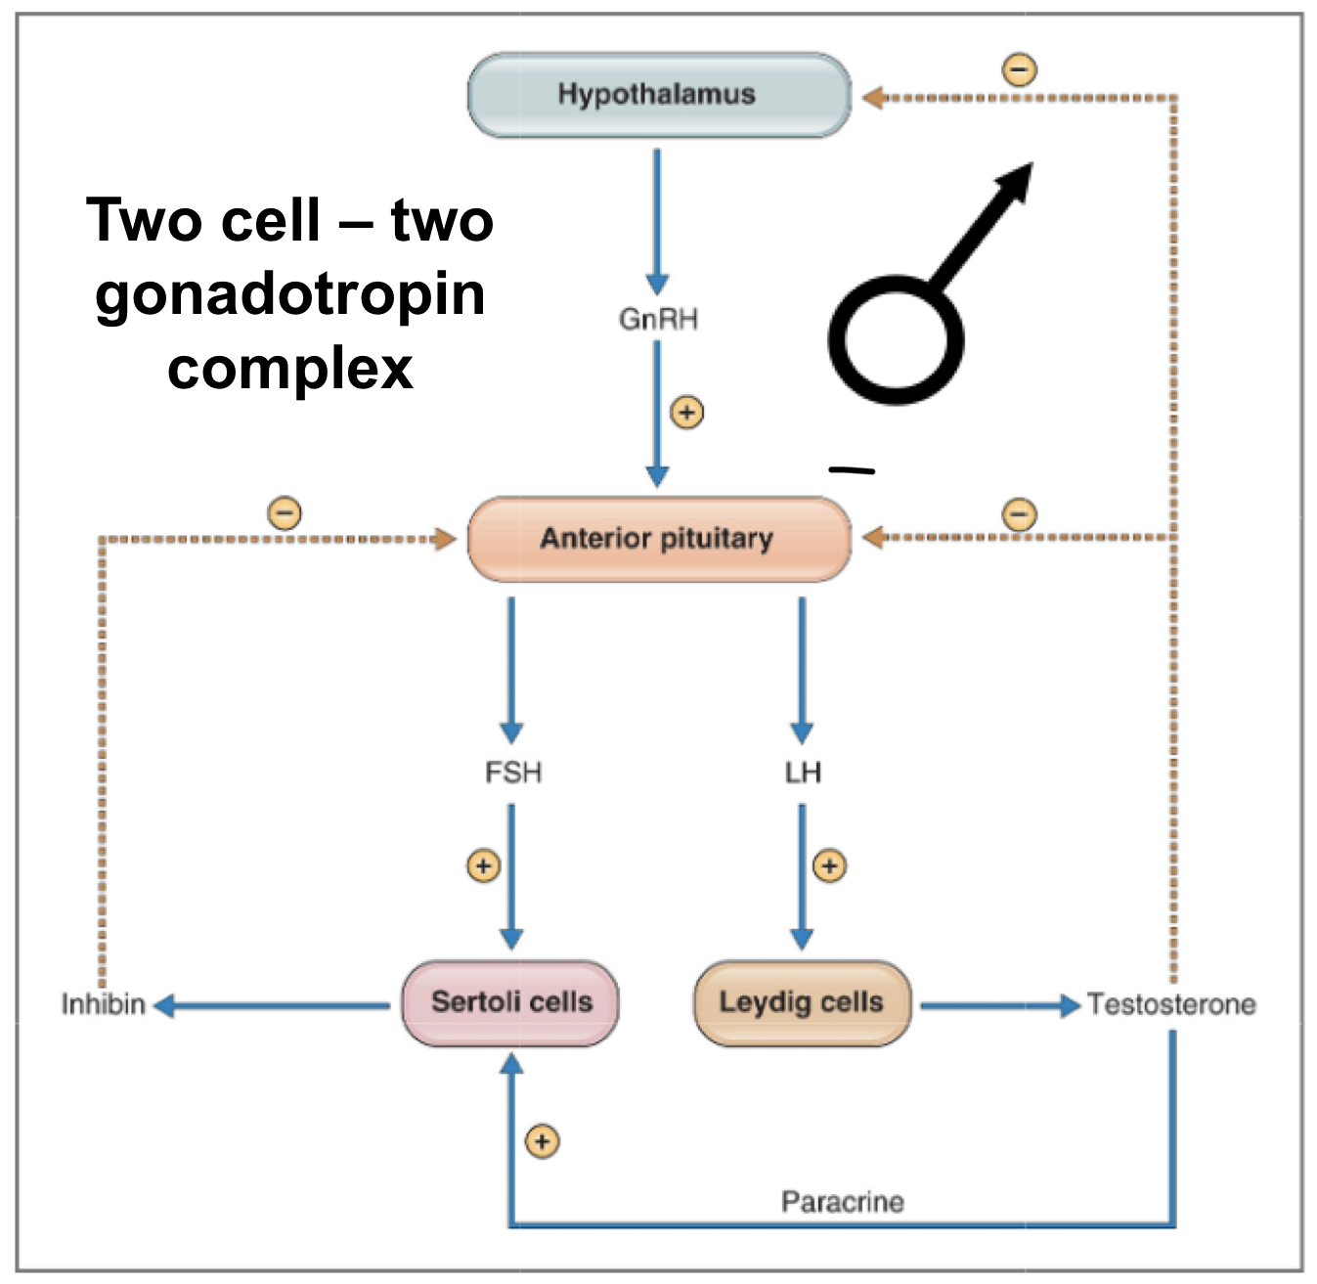
HPG axis:
GnRH agonists:
Estrogen:
LH action:
Male: LH acts on Leydig cells of testes responsible for producing testosterone
Female: LH induces ovulation and facilitates the production of progesterone by corpus luteum
FSH actions:
Male: acts on testis and Sertoli cells, where sperm develops
Female: maturation of ovarian follicles during first part of menstrual cycle and production of estrogen by the ovary
GnRH stimulates gonadotropin release by hypothalamus → increase LH and FSH
Sustained non-pulsatile administration of GNRH or GnRH analogs → inhibits release of FSH or LH by pituitary in women/men results in hypogonadism
Ovulation stimulation → IVF
Sustains → OFF- GnRH with initial flare
ADE: hot flashes, gynecomastia, venous thromboembolism
Hepatic– prothrombic
Pregnancy– category X
Uterine neoplasm
Boxed warning:
Estrogen should NOT be used to prevent CHF
Increased risk: dementia
W/o progastrin – Increased endometrial CA in women with uterus
CI: Hx of DVT, stroke, estrogen dep’t tumor, hepatic dysfunction, migraine w/ ir w/o aura, smoker
GnRH– pulsatile- ↑ LH/FSH
Continuous-- ↓ LH/FSH
Leuprolide sustained release (Lupron depot)
GnRH antagonist:
No flare
Treats: prostate CA
SERD:
Estrogen antagonist
Tx: breast CA with resistance to tamoxifen
Degarelix
Fulvestrant
Aromatase inhibitors:
Testosterone Antagonist:
Progesterone :
SERM (partial agonist) :
Prevent “flare” from leuprolide
Treats: prostate CA
Testosterone flare = rise in testosterone d/t increased LH: initiation of LHRH agonist
Small tumor growth during metastasis
CV crisis
Endometrium: decrease endometrial proliferation
Repro: w/d → mensuration
SPRM: Progesterone Partial Agonist
Pregnancy--Absolute CI
Progesterone Antagonist
Abortion of fetus or used to cause uterine contractions
Clomiphene– follicular growth
Ospemifene– dyspareunia
Raloxifene– prevent (not treat) breast CA
Ex. Mother has B. CA but patient doesn’t
Tamoxifen– receptor antagonist– breast agonist in endometrium
ADE: endometrial CA
Activated by 2D6 (SSRI inhibits this)
Prevents osteoporosis in B. CA
FSH stimulates growth of ovarian follicles and induces LH receptor expression and induces aromatase expression
AE: increased risk of fracture, testosterone increase, no risk of endometrial CA (contrasted with SERM because SERM is short so no bone loss and is an agonist in endometrium so can increase risk of CA; BOTH are GnRH antagonist)
Flutamide, bicalutamide, nilutamide
5-alpha reductase antagonist:
Blocks androgens, DHT
Helps with hair loss
Risk of harm to exposed fetus (via semen or transdermal)
Pregnant women should NOT handle these tablets!
pseudohermaphrodite XY fetus
Progesterone: norethidrone, norgestrel
SPRM: uprisal
Progesterone antagonist: mifeprisone
Anastrozole
Finasteride
Raloxifene, clomiphene, tamoxifen
Notes:
Lecture 37: Gonadal Hormones and Inhibitors

Slide 6
Exogenous Insulin
Renal problem or HF?
Choose Insulin
Secretagogues
Hypoglycemia
Insulin affects– liver, skeletal muscle, fat cells
AE: hypoglycemia, weight gain, hypokalemia, no c-peptide
Hypoglycemia: B-blockers may mask symptoms
Hypokalemia: Glu and K⁺ shifts into skeletal muscle
GLUT 2– B cell– Glu sensor
GLUT 4– insulin mediates glucose uptake in muscle and adipose tissue
Short: similar to endogenous insulin + Zn²⁺ -- stable
Hexanes → monomers slowly
Rapid: modification to monomer
Quick monomers from weak hexamers
Intermediate: INH– regulates insulin + (Zn²⁺ + protamine) delayed absorption
Long (peakless): don’t mix glargine & detemir → crystalized
Rapid/Short: skip meal, skip dose
MOA: Block K⁺-ATP channel in B-islet cell → depolarize, Ca²⁺ influx, insulin release
Increase insulin in body
Sulfonylurea and Glitinide
On a-glucosidase I: dextrose → best
Glucagon or IV glucose – unconscious
Hyperinsulinemia → hypoglycemia
Octreotide– blocks insulin & glucagon release
Diazoxide– open K⁺ channel → B-cell hyperpolarization → ↓ Ca²⁺ influx, ↓ insulin release → hypotension
Drugs that Increase Insulin
Weight Gain: SIT
Sulfonyurea (-ride)
Insulin
TZD (-glitazone)
SIMmer down:
Sulfonyurea
Insulin
Meglitinides
Rapid: insulin aspart, lispro, glulisine
Short: regular insulin
Intermediate: insulin NPH
Peakless: regular insulin glargine, detemir
Sulfonylurea: glyburide, chlorpropamide, tolbutamide
Glitinide: repaglinide
Glucagon, glucose (dextrose), sucrose, octreotide, diazoxide
Biguanide
Thiazolidinediones
(TZD)
↓ Carb
absorption:
Incretin:
SGLT2 I:
Amylin analogues:
GLP-1 Agonists:
Increase post-prandial insulin release
Suppress glucagon
AE: pancreatitis
Adv: weight loss → decrease appetite
DPP-4 Inhibitor:
Increase insulin concentration, decrease glucagon
FDA warning: Incr HF risk w/ hx of HF renal a
Increase glucose excretion in urine
AE: hypovolemia/
hypotension, hyperkalemia
Avoid in renal failure
MOA: decreased hepatic glucose production
100% excretion by kidneys– increase in body in renal failure
Lactic Acidosis: risk of CHF, renal failure, hepatic dysfunction, alcohol abuse, sepsis
Reduced in ½ w/ GFR <45 and stop <30
Metformin:
Contraindicated in HF d/t increase in LA
Decrease mealtime insulin dose
AE: hypoglycemia
MOA: alpha glucosidase inhibitor
Decrease absorption/digestion complex carbs → decrease PPG
PPARy agonist
Decrease blood glucose → increase glucose transport
AE: increase ENaC → edema → HF worse
CI: CHF
TZD:
CI in HF d/t ability of ENaC-– makes HF worse
Activity w/o Insulin ↑ Secretion
Decrease absorption of dietary glucose
Decrease hepatic glucose release and increase insulin sensitivity
GLP-1: Exenatide
DPP-4 I: Sitagiliptin, Saxagiliptin
Metformin
Pioglitazone
Acarbose
Canagliflozin, Dapagliflozin
Pramlintide
Notes:
Lecture 38 & 39: Glucose and Insulin

Slide 8
HSV and Varicella
CMV
Acyclovir MOA: Phosphorylated by viral kinase and become inhibitor of viral DNA synthesis
Use: genital herpes, varicella-zoster, HSV encephalitis, neonatal HSV, serous HSV, or varicella
Docosanol: MOA: fusion inhibitor – prevent entry into cells and replication
AE: nephrotoxic
Ganciclovir MOA: inhibits activity against HSV especially CMV; inhibits DNA synthesis
Monophosphorylated by viral thymidine
Monophosphorylated by viral phosphotransferase → has to use viral DNA→ can become resistant
AE: myelosuppression, neutropenia
Cidofovir: complete inhibition of DNA synthesis and incorporation into viral DNA
Phosphorylation is independent of viral enzyme-– activity is maintained vs thymidine kinase deficiency or altered structure of CMV or HSV
AE: dose-dependent PCT nephrotoxicity– must administer with probenecid
Foscarnet: w/o requirement of activity by phosphorylation
AE: nephrotoxicity
Acyclovir, docosanol
Ganciclovir, Cidofocir, Foscarnet
Influenza
Hepatitis B
Hepatitis C
MOA: competitive and reversible interaction with active enzyme site to inhibit viral neuraminidase activity resulting in clumping of newly released virions to each other and membrane of infected cell
Early administration is crucial-– replication peats at 24-72 hours after illness
Adefovir– inhibits HBV DNA polymerase and reverse transcriptase, causes chain termination after incorporation
Acute exacerbation upon discontinuation
Entecavir– competitively inhibits all 3 fxns of Hep B DNA polymerase
Acute exacerbation upon discontinuation
Telbivudine– inhibits HBV DNA polymerase incorporation into viral DNA causes chain termination
Pegylated interferon alfa-2a/2b– slow clearance, longer t_{1/2}, steadier concentration → less frequent dosing
Ribavirin: guanosine nucleoside analog
AE: Toxic! Hemolytic anemia, fatigue, neutropenia, hyperuricemia
Exposed should not conceived children for at least 6 months thereafter
Healthcare workers may experience AEs (HA, conjunctivitis, rhinitis, nausea, rash)
Protease NS3/4A inhibitor– combined with peginferon and ribavirin
CYP3A4 inhibitor
NPIs– administration w/ amiodarone is not recommended d/t sxs– bradycardia + fatal cardiac arrest
Ritonavir– strong CYP3A4 inhibitor
Contact doctor if you develop: fatigue, weakness, loss of appetite, NV, jaundice, light-colored stools → serious liver problems (but don’t stop taking)
Monitor HCV/HBV co-infected patients for hepatitis flare or hepatitis B reactivation during HCV treatment and post-treatment follow-up. Initiate appropriate patient management for HBV infection as clinically indicated
Oseltamivir
Adefovir, Entecavir, Telbivudine
Ribavirin, Pegylated interferon alfa-2A/b, Protease NS3/4 I: simeprevir
NS5A: daclatasvir, ledipasvir, ombitasvir
NPI: sofosbuvir
NNPIs: dasabuvir
Ritonavir
Notes:
Lecture 40: Antivirals

Slide 9
Entry Inhibitor:
NRTI:
NNRTI:
Inhibits fusion: site reaction (in 98%)– erythema, nodules, cysts
Binds CCR5 receptor: Prevents gp120
Tropism must be test-– make sure they have the CCR5 receptor
AE: mitochondrial toxicity, lactic acidosis
Zidovudine– insulin resistance, dyslipidemia
All substrates for CYP 34A
AE: skin rash, teratogenic
Didanosine, abacavir, zidovudine, lamivudine, tenofovir
Inhibits fusion: enfuvirtide
Binds CCR5 Rec: maraviroc
HIV:
Multi-drug Combos
Efavirenz, delavirdine
Integrase Strand Transferase Inhibitor:
Protease Inhibitor:
HIV infection in Women:
Booster :
Prevent metamorphosis of HIV into mature form
Ritonavir-– enhancer to keep drug around longer
AE: hyperglycemia, lipodystrophy (buffalo hump)
Generally used IV during labor and delivery to prevent transmission to the fetus and given orally for 6 weeks to newborn
Zidovudine– insulin resistance, dyslipidemia
CYP3A4 inhibitor not against HIV used to boost level of other drugs
Raltegravir
Zidovudine
Cobicistat
Lopinavir, Ritonavir, Atazanavir, Darunavir, Fosamprenavir, Indinavir
Notes:
Lecture 44: Antiretrovirals-- HIV

Slide 10
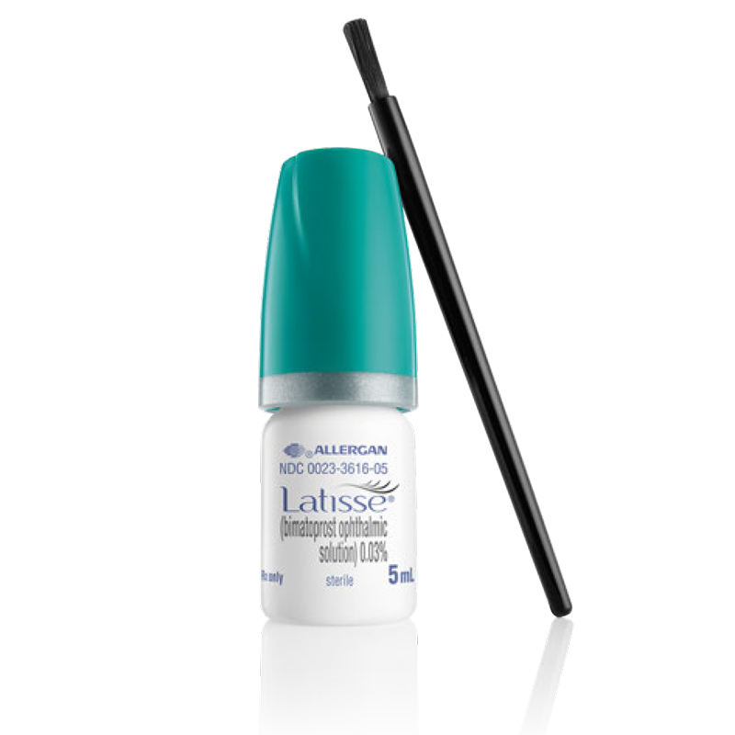
Prostaglandin analogs:
Beta Blockers
Carbonic anhydrase Inhibitor
Sympathomimetics
Increase uveoscleral outflow
MOA: PGF2a analog and lower IOP by facilitating aqueous outflow through accessory uveoscleral outflow
AE: may cause pigmentation of iris; eyelash changes (increase thickness)
ABC’s decrease aqueous production:
A₂ agonists, B-blockers, Carbonic anhydrase inhibitors
Helps with open angle glaucoma
Helps with glaucoma
AE: bradycardia, HF, depression
Betaxolol less effective but has protective effect on retinal neurons
Decrease aqueous production or increases the uveoscleral outflow via B2 (decreases IOP)
Dipivefrin-- increase aqueous outflow
Brimonidine-– selective a2 adrenergic agonist, lipophilic, penetrates eye
Reduces aqueous humor production
Used in glaucoma
Inhibits carbonic anhydrase in the ciliary body epithelium
AE: bitter taste, burning, hypersensitivity, keratitis, allergic reaction when allergic to Sulfa drugs
Ex. Patient has allergy to Sulfa– don’t give this drug– they will also be allergic to this
Lantanoprost
Bextaolol, Timolol
Acetazolamide
Dipivefrin, Brimonidine
Cholinergic/Antichol:
Muscarinic antagonists:
Decongestants:
NSAIDs/Glucocorticoids:
Muscarinics (agonists) cause constriction of pupil
Blocks M receptors → causes dilation of pupil– inhibits contraction of circular pupillary sphincter muscle
Paralysis of accommodation (cycloplegia) paralysis of ciliary muscle
Used to visualize internal structure of the eye
Sympathomimetics
MOA: phenylephrine-- post-synaptic alpha agonist; vasoconstricts and causes mydriasis– gets rid of red eye
NSAIDs
MOA: inhibits COX-1 and 2
CI: severe renal insufficiency
Use: post-operative inflammation
Glucocorticoids
MOA: anti-inflammatory
Use: corneal/intraocular surgery-- post-operatively; age-related macular degeneration (ARMD)
Long term use: cataracts
Cholinergic--Causes miosis
Anticholinergics– Causes mydriasis, photophobia
Cholinergic Agonists– stimulates muscarinic receptors → increase outflow
Increase Ach
AchE - decrease the degradation of Ach so they increase amount of Ach
AE: CF, hyperthyroidism, Parkinson’s, urinary tract obstruction, bronchial asthma, peptic ulcer disease
Cholinergic: pilocarpine
Cyclopentolate
Phenylephrine
NSAIDs: Diclofenac
Glucocorticoids: Dexamethasone, Prednisolone
Notes:
Lecture 45: Ocular Medicine

Slide 11
Antimuscarinics
AchE inhibitor and Organophosphates
Normal blood pressure, pupils not reactive to light/accommodation, skin flushed and dry, mucus membranes dry, bowel sounds hypotonic, urinary bladder distended
Toxidrome: ”Hot as a hare, dry as a bone, red as a beet, blind as a bat, mad as a hatter”
Fever, tachycardia, mydriasis, flushing, dryg skin, agitation, hallucinations, psychosis, seizures, coma, anti-SLUD
Antidote: physostigmine
Five old Auntie Muscarinic:
Antiarrhythmic (Ia), Antidepressants (tricyclic), Antipsychotics, Antihistamines, Ant-Parkinson’s, + cyclobenzaprine
Note that sympathomimetics have similar symptoms but have high BP
Question usually is about a farmer exposed to pesticide
Sxs: Low HR, high BP; diaphragm paralysis; diarrhea, fasciculations followed by paralysis, diaphoretic, cold pale, hyperkalemia
Tx: atropine, pralidoxime
Atropine, Datura stramonium; tx: physostigmine
Malathion, Sarin; tx: atropine, pralidoxime
Aspirin Toxicity
Miosis
Overdose: 1º respiratory alkalosis → metabolic acidosis (Lack of ATP, decreased pCO₂)
Presents with fever; hyperventilation
Sxs: tinnitus
Inability to use oxidative phosphatase→ leads to shift to anaerobic use of pyruvate and metabolic acidosis
Tx: bicarbonate (water serum potassium)
Causes hypokalemia: Drugs causing hypokalemia-- “DO Insulin LAB”– Digitalis, hyperosmolarity, Insulin deficiency, lysis of cells, acidosis, B-blockers
COCO: Cholinergic, Clonidine, Opiates, Organophosphates
Cholinergic: bradycardia, hypotension, sialorrhea, urinary incontinence, increased bowel sounds
Clonidine: bradycardia, hypotension; minimal impact on salivation, urination, bowel sounds
Opiates: diminished bowel sounds, severe depression of respiratory drive
Organophosphates: initial HTN, muscle fasciculations, paralysis
Tx: sodium bicarbonate
Spironolactone, eplerenone
Notes:
Lecture 47: Toxidromes

Slide 12
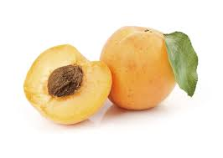
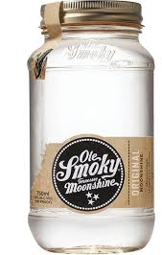
Cyanide
Iron
Cyanide from smoking wool or eating a bunch of apricot pits
Cyanide has an increased affinity for Fe³⁺ than Fe²⁺
Use nitrates and nitrites to induce methemoglobinemia
Tx for CN:
Use nitrate → induces methemoglobinemia
Binds tightly to heme O₂ to ox to Fe³⁺
Use Na⁺ Thiosulfate – renally cleared
Hydroxocobalamin (B12)-– binds to CN
Acute toxicity: GI– necrotizing gastroenteritis: NV, pain, bloody diarrhea, shock, metabolic acidosis, hepatotoxicity, coma death, GI stricture/scarring, hepatic fibrosis
Chronic: hemochromatosis
Antidote: Deferoxamine– binds ferric iron
SE: immune response– histamine release and vasodilation
Sodium nitrite, nitroprusside
Deferoxamine
Lead
In heme biosynthesis d-ALA with poisoning – increases urinary excretion of d-ALA
Sxs: ringed sideroblasts, anemia, metaphyseal bands, wrist drop, encephalopathy, lowered IQ in kids, HTN, dark gum line
Sources: paint, plumbing, imported food packaging, moonshine
Antidotes: BAL or dimercaprol, CaNa² EDTA (after administration of dimercaprol), Succimer, penicillamine
(1) Dimercaprol → (2) Ca²⁺ Disodium EDTA
Dimercaprol, Calcium disodium EDTA, BAL, Succimer, penicillamine
Notes:
Lecture 48: Environmental Toxins
↓ ↑

