Slide 1
TIME MANAGEMENT
AARON PHILLIPS, PHD
DIRECTOR OF Academic Support

Slide 2
Jar of Life:
https://www.youtube.com/watch?v=6_N_uvq41Pg
Thoughts?

Slide 3
Jar of Life:
Large rocks?
Classes, labs, etc.
Pebbles?
Individual study, group study, tutor sessions, etc.
Sand?
Hobbies, friends, social events, etc.
Water?
Any non-productive time wasters

Slide 4
Importance of a Time Management Schedule:
Why create and stick to a time management schedule?
In my opinion, how you manage and allocate your time is perhaps THE most important key to your success in medical school.

Slide 5
Benefits of Time Management
Identify goals
Establish priorities
Practice decision making skills
Allows you to take responsibility for the outcome
Monitor progress
Produces feelings of accomplishment
Reduces stress level
Helps to avoid work overload or burnout
A “To-do” list does not accomplish all of these

Slide 6
What happens if you don’t have an adequate time management schedule?
Engaging in time wasters
Lack of prioritization
Difficult to assess where problems may be

Slide 7
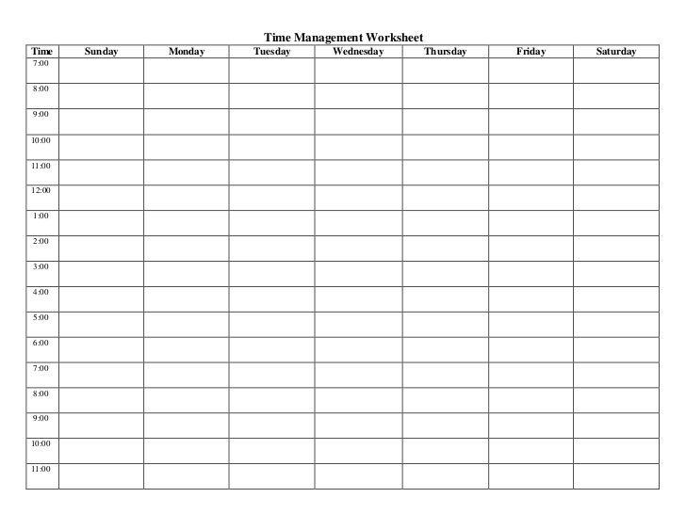
Steps to time management
Step 1: start with a blank worksheet

Slide 8
Steps to time management
Step 2: build into your schedule first any required activities such as courses and labs (Large Rocks)
Time | Sunday | Monday | Tuesday | Wednesday | Thursday | Friday | Saturday
7:00
8:00 |  | MGA | MFM 1 | Med Histo | FMHC 1 | OPP 1
9:00 |  | MGA | MFM 1 | Med Histo | FMHC 1 | OPP 1
10:00 |  | OPP 1 | EPC 1 | EPC 1 | MGA | FMHC 1
11:00 |  | OPP 1 | EPC 1 | EPC 1 | MGA | Med Histo
12:00 |  | Lunch | Lunch | Lunch | Lunch | Lunch
1:00 |  | FMHC 1 | MGA | OPP 1 | MFM 1
2:00 |  | FMHC 1 | MGA | OPP 1 | MFM 1
3:00 |  |  | FMHC 1 | FMHC 1 | EPC 1
4:00
5:00
6:00
7:00
8:00
9:00
10:00
11:00

Slide 9
Steps to time management
Step 3: add routine activities to your schedule (Grooming, driving to school, breakfast, etc.)
Time | Sunday | Monday | Tuesday | Wednesday | Thursday | Friday | Saturday
7:00 | Grooming, Breakfast | Breakfast, drive to school | Breakfast, drive to school | Breakfast, drive to school | Breakfast, drive to school | Breakfast, drive to school | Grooming, Breakfast
8:00 |  | MGA | MFM 1 | Med Histo | FMHC 1 | OPP 1
9:00 |  | MGA | MFM 1 | Med Histo | FMHC 1 | OPP 1
10:00 |  | OPP 1 | EPC 1 | EPC 1 | MGA | FMHC 1
11:00 |  | OPP 1 | EPC 1 | EPC 1 | MGA | Med Histo
12:00 | Lunch | Lunch | Lunch | Lunch | Lunch | Lunch | Lunch
1:00 |  | FMHC 1 | MGA | OPP 1 | MFM 1
2:00 |  | FMHC 1 | MGA | OPP 1 | MFM 1
3:00 | Make Time Mgmt Schedule |  | FMHC 1 | FMHC 1 | EPC 1
4:00 | Grocery, Laundry | Exercise | Exercise | Exercise | Exercise | Exercise
5:00 | Grocery, Laundry
6:00 | Dinner | Dinner | Dinner | Dinner | Dinner | Dinner | Dinner
7:00
8:00
9:00
10:00
11:00

Slide 10
Steps to time management
Step 4: build in study time and be specific (Pebbles)
Time | Sunday | Monday | Tuesday | Wednesday | Thursday | Friday | Saturday
7:00 | Grooming, Breakfast | Breakfast, drive to school | Breakfast, drive to school | Breakfast, drive to school | Breakfast, drive to school | Breakfast, drive to school | Grooming, Breakfast
8:00 | Flex/Catchup | MGA | MFM 1 | Med Histo | FMHC 1 | OPP 1 | Basic Study Time
9:00 | Flex/Catchup | MGA | MFM 1 | Med Histo | FMHC 1 | OPP 1 | Basic Study Time
10:00 | Flex/Catchup | OPP 1 | EPC 1 | EPC 1 | MGA | FMHC 1 | Meet with Study Group
11:00 | Flex/Catchup | OPP 1 | EPC 1 | EPC 1 | MGA | Med Histo | Meet with Study Group
12:00 | Lunch | Lunch | Lunch | Lunch | Lunch | Lunch | Lunch
1:00 | Basic Study Time | FMHC 1 | MGA | OPP 1 | MFM 1 | Basic Study Time | Practice Questions
2:00 | Basic Study Time | FMHC 1 | MGA | OPP 1 | MFM 1 | Basic Study Time | Practice Questions
3:00 | Make Time Mgmt Schedule | Quick Review | FMHC 1 | FMHC 1 | EPC 1 | Basic Study Time | Practice Questions
4:00 | Grocery, Laundry | Exercise | Exercise | Exercise | Exercise | Exercise | Practice Questions
5:00 | Grocery, Laundry | Basic Study Time | Quick Review | Quick Review | Quick Review | Quick Review | Practice Questions
6:00 | Dinner | Dinner | Dinner | Dinner | Dinner | Dinner | Dinner
7:00 | Basic Study Time | Basic Study Time | Basic Study Time | Basic Study Time | Basic Study Time | Basic Study Time
8:00 | Basic Study Time | Basic Study Time | Basic Study Time | Basic Study Time | Basic Study Time | Basic Study Time
9:00 | Basic Study Time | Practice Questions | Practice Questions | Practice Questions | Practice Questions | Basic Study Time
10:00 | Preview | Preview | Preview | Preview | Preview | Practice Questions
11:00 | Get ready for bed | Get ready for bed | Get ready for bed | Get ready for bed | Get ready for bed | Get ready for bed | Get ready for bed

Slide 11
Study time should consist of:
Previews (15 minutes per lecture, on average each weekday this is probably about one hour)
Quick reviews (Similar to previews, about 15 minutes per lecture, on average each weekday this is probably about one hour)
48 hour and other reviews (this can be very challenging, but try to fit this in as much as possible)
Basic study time (Hit your most challenging courses at least once per day if possible, consolidating and integrating information from PowerPoints, text, external resource, etc.) For your less challenging courses, try for every other day.
Practice Questions (MCQs) goal should be at least 2-3 times per week for maybe 1 hour with a larger chunk of time set aside on the weekend

Slide 12
Study time may also consist of:
Meeting with a study partner or study group
Attending Tutor sessions
Spending extra time on hard/challenging topics
Catch-up or Flex time/Open Study time

Slide 13
Steps to time management
Step 5: Review your schedule and make sure to include anything that takes up time (Sand and possibly water)
Time | Sunday | Monday | Tuesday | Wednesday | Thursday | Friday | Saturday
7:00 | Grooming, Breakfast | Breakfast, drive to school | Breakfast, drive to school | Breakfast, drive to school | Breakfast, drive to school | Breakfast, drive to school | Grooming, Breakfast
8:00 | Flex/Catchup | MGA | MFM 1 | Med Histo | FMHC 1 | OPP 1 | Basic Study Time
9:00 | Flex/Catchup | MGA | MFM 1 | Med Histo | FMHC 1 | OPP 1 | Basic Study Time
10:00 | Flex/Catchup | OPP 1 | EPC 1 | EPC 1 | MGA | FMHC 1 | Meet with Study Group
11:00 | Flex/Catchup | OPP 1 | EPC 1 | EPC 1 | MGA | Med Histo | Meet with Study Group
12:00 | Lunch | Lunch | Lunch | Lunch | Lunch | Lunch | Lunch
1:00 | Basic Study Time | FMHC 1 | MGA | OPP 1 | MFM 1 | Basic Study Time | Practice Questions
2:00 | Basic Study Time | FMHC 1 | MGA | OPP 1 | MFM 1 | Basic Study Time | Practice Questions
3:00 | Make Time Mgmt Schedule | Quick Review | FMHC 1 | FMHC 1 | EPC 1 | Basic Study Time | Practice Questions
4:00 | Grocery, Laundry | Exercise | Exercise | Exercise | Exercise | Exercise | Practice Questions
5:00 | Grocery, Laundry | Basic Study Time | Quick Review | Quick Review | Quick Review | Quick Review | Practice Questions
6:00 | Dinner | Dinner | Dinner | Dinner | Dinner | Dinner | Dinner
7:00 | Basic Study Time | Basic Study Time | Basic Study Time | Basic Study Time | Basic Study Time | Basic Study Time | Free time
8:00 | Basic Study Time | Basic Study Time | Basic Study Time | Basic Study Time | Basic Study Time | Basic Study Time | Free time
9:00 | Basic Study Time | Practice Questions | Practice Questions | Practice Questions | Practice Questions | Basic Study Time | Free time
10:00 | Preview | Preview | Preview | Preview | Preview | Practice Questions | Free time
11:00 | Get ready for bed | Get ready for bed | Get ready for bed | Get ready for bed | Get ready for bed | Get ready for bed | Get ready for bed

Slide 14
What else might take up time?
Phone conversations with family members
Any routine task (grocery, laundry, etc.)
Anything else that comes to mind?

Slide 15
Keys to being successful with your time management schedule:
Be as specific as possible, do not put “study” for a 4 hour block, indicate the course, the resource (text, PPT, external, etc.), be as specific as you can about what you plan to do for that hour
Be flexible! It will never be 100% perfect, life happens!
Add FLEX time to account for this
Have an accountability partner!
Use a format that is comfortable for you
DON’T GIVE UP!!

Slide 16
Other things to consider:
Take a break every hour for about 10 minutes
Try (as much as possible) to switch your course study (or at least your topics) every hour
If a full week is too intimidating, try a day at a time at first, with the goal of working up to a full week
Never plan for more than one week in advance
Other option is to create a type of checklist

Slide 17
Time Management Alternative Checklist:
Course | Preview | Quick Review | 48 hour review | Weekend review | Condensed notes | Practice Questions MCQs | Other | Total
MGA | X 8/5, 2 hours
MFM 1
Medical Histology
OPP 1
EPC 1
FMHC 1

Slide 18
Also consider when planning your time management schedule:
Calculate the number of hours you have for study in your schedule over the course of the week. Consider previews, reviews, practice questions, basic study time, etc.
Rank order your classes from most to least challenging
Allocate hours based on your ranking, e.g. Endocrine15 hours, Derm 12 hours, Beh Med 10 hours

Slide 19
Also consider when planning your time management schedule:
This allows you to put more time into your more challenging courses, but not neglect your other classes.
For your more challenging courses, you should definitely be reviewing every day, for others, plan your schedule accordingly so you review at least every other day.

Slide 20
Accountability Partner
Pick at least one other student here today to be your accountability partner for this semester
Think of this like a gym partner, someone to help motivate you and keep you on track with your time management schedule

Slide 21
Upcoming workshops:
January 28th: Working with Practice Questions
February 11th: Managing Test Anxiety and Avoiding Burnout
February 26th: Exam reflection activity
March 10th: Creating a Study Guide
March 31st: “Add Your Patient” activity, creating your own Practice Questions
April 14th: Medical Terminology
April 28th: Best student idea/recommendation

Slide 22
Work on your own:
Spend the remaining time with a partner in the group creating your time management schedule for the next week and getting his or her feedback

