Slide 1
Terrifyingly Tactical Test Taking Techniques
Because taking tests is:
a. Easy
b. Great
c. Terrific
d. An unavoidable part of medical school and life is a test anyway so it’s never ending

Slide 2
What’s going to happen today?
Before the Test
During the Test
After the Test
Real Examples from Real People

Slide 3
Who are you on test day?
Number 1, 2, or 3?

Slide 4
Before the Test
Preparation is Key
Check your study habits
What are you doing? Where are you doing it? Who are you doing it with?
Ask yourself: “When I finish studying, do I feel any different than when I began?”
Check your practice questions
Hint: If you’re not using practice questions, you’re doing it wrong.

Slide 5
Before the Test
Stress Relief
Have a routine
Pre-exam playlist, 20 pushups, Frosted Flakes and Apple Juice...
Eat a good dinner AND breakfast
Sleep!
Don’t cram

Slide 6
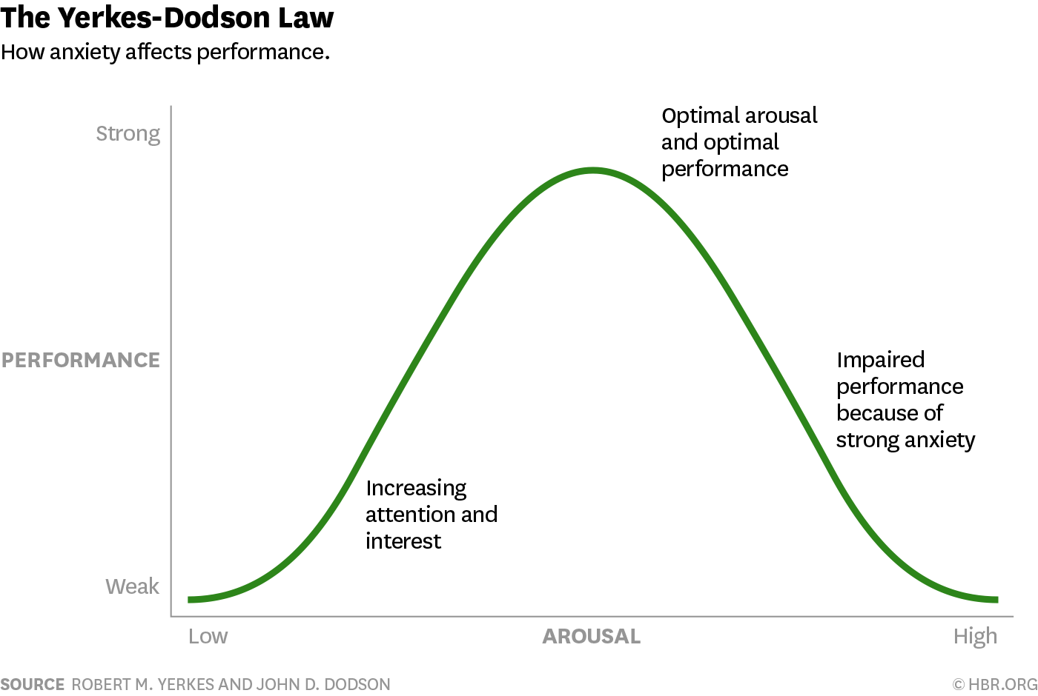
Before the Test
If you are stressed some, that’s okay (and healthy!)
(Stress)

Slide 7
During the Test
Start at the Beginning – The Question
Read the question first. Slowly.
As soon as you move to a new question, use your hand or scrap paper to cover up the answers. The question is all that matters right now.
Parts of a question:
The Stem - This is the section above the answer choices
Read it! Don’t skim and make assumptions.
Highlight key information
Confused? Rephrase the question in your words answering “what is the stem telling me?” or “what is the question asking me?”
The Last Sentence - This is often where the actual question lives.
Formulate an answer

Slide 8
An Example
Student A arrives late to lecture on Monday. As they come in, they realize they’ve missed the password to the IRAT currently in progress. As they take their seat, Student B whispers the password to Student A.
What ethical principle is the student giving the password out violating?
Adhering to High Ethical and Moral Standards
Exhibiting a Commitment to Scholarship and Advancing Their Field
Exercising Accountability for Themselves and Their Colleagues
Demonstrating a Commitment to Excellence

Slide 9
During the Test
Answers Are…Confusing?
Multiple choice means you NEED to make a choice
There is always a most correct answer
There will usually be distractors
Distractors could be right given the right situation – Does it fit this situation, though?
Distractors sound attractive or familiar – So what? Say hello and keep moving.

Slide 10
During the Test
Answers Are…Confusing?
Narrow down the answers
Mark out the ones you know are wrong (trust yourself!)
Eliminate distractors
Re-read the question, not the answers
Don’t “talk yourself into” an answer
Just because something is true doesn’t mean it’s right – is it true in this situation?

Slide 11
During the Test
Answer the question!
What’s left after you’ve eliminated? 1 choice? 2 choices?
Still can’t decide? Pick the one you think is best and move on.
Do a quick double-check – Does the answer you chose answer the question being asked (not the question I’m assuming is being asked)?

Slide 12
An Example
Which of these assessment findings, if identified in a client who has pneumonia, indicates that the client needs to be suctioned?
T
Chest pain that worsens when breathing deeply, laughing, or coughing
Respiratory rate of 18 breaths per minute
Inability to clear sputum
Wheezing prior to bronchodilator therapy
Sudden, severe shortness of breath and coughing up pink, foamy mucus
F
T
F?
?

Slide 13
During the Test
Stress Relief
Deep breaths
Look up some
One question at a time

Slide 14
After the Test
Reward yourself
Ice cream, shopping, video games, go downtown, whatever makes you happy
Don’t dwell
Dwelling on what you think you could have maybe possibly not answered correctly…won’t change your answer
Don’t compare
*See previous description*

Slide 15
When Grades Are Released
Did awesome?
Keep going but keep assessing
Didn’t do as well as you hoped?
Learn from the experience
How did you prepare? How can you make that more active? How can you tweak or change your strategies?
Come meet with me
No matter the outcome, continue to monitor stress levels and habits

Slide 16
Real Questions from Real People
A 3-year-old male presents to the clinic with shortness of breath and his mom states that he tires easily. Mom denies any recent illness and patient is not febrile. Upon exam, the physician determines that the opening in the septum secundum is still patent. Which structure failed to close?
A. Coronary sinus
B. Ductus arteriosus
C. Ductus venosus
D. Foramen ovale
E. Ligamentum arteriosum

Slide 17
Real Questions from Real People
A 3-year-old male presents to the clinic with shortness of breath and his mom states that he tires easily. Mom denies any recent illness and patient is not febrile. Upon exam, the physician determines that the opening in the septum secundum is still patent. Which structure failed to close?
A. Coronary sinus – venous drainage for the heart
B. Ductus arteriosus - connects the pulmonary trunk with the arch of the aorta thus allowing fetal blood to bypass the lungs
C. Ductus venosus - shunts a portion of umbilical vein blood flow directly to the inferior vena cava. Thus, it allows oxygenated blood from the placenta to bypass the liver
D. Foramen ovale
E. Ligamentum arteriosum- formerly the ductus arteriosus

Slide 18
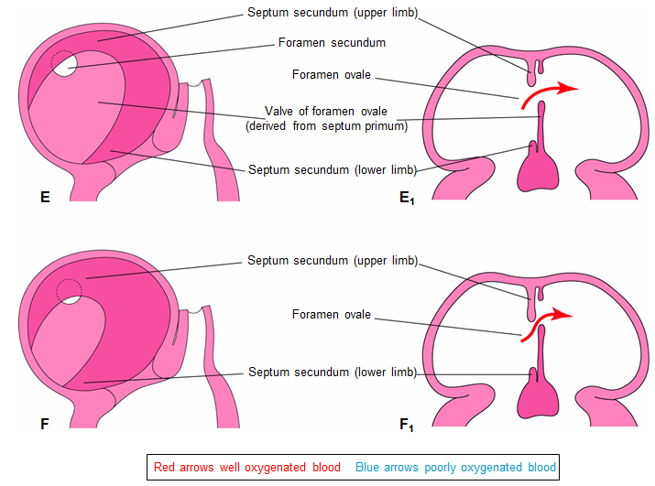
Partitioning of the Atrium
The septum secundum (thick, muscular) grows inferiorly, but leaves opening – foramen ovale

Slide 19
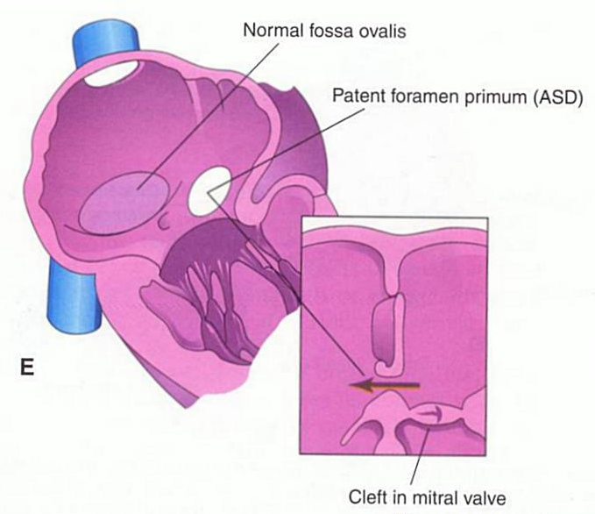
Septum Primum Malformation
Caused by failure of septum primum to completely fuse with endocardial cushion
Leaves a variably sized hole connecting the two atria
The malformation can also cause malformations in the A-V valves
This malformation is frequently found in down’s syndrome

Slide 20
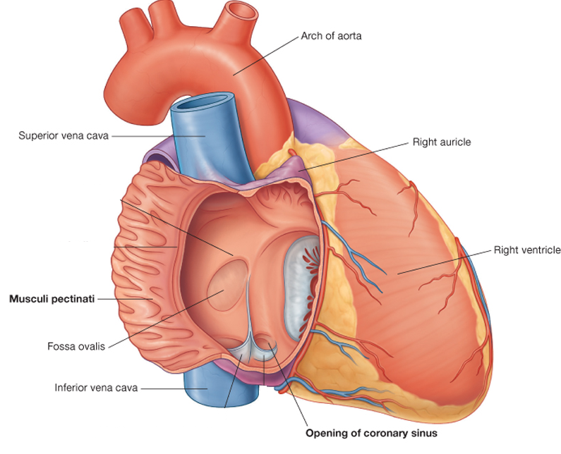
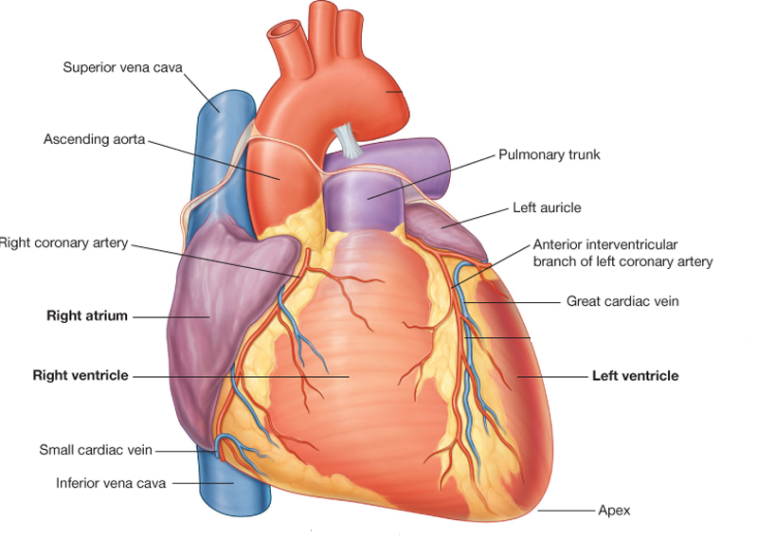
Fetal “Shortcuts”
Foramen Ovale – allows oxygenated blood entering the right atrium to pass directly into the left atrium to bypass the nonfunctional fetal lungs → becomes the Fossa Ovalis
Ductus Arteriosus – connects the pulmonary trunk with the arch of the aorta thus allowing fetal blood to bypass the lungs → becomes the Ligamentum Arteriosum
1
2

Slide 21
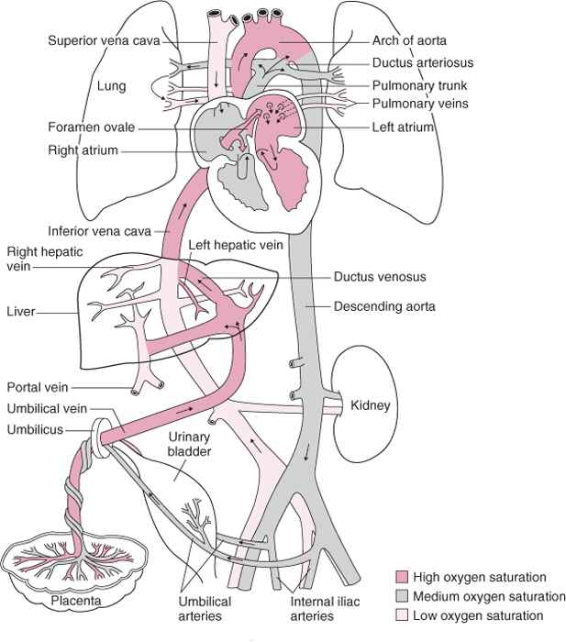

Slide 22
A 37-year-old female is admitted to the hospital with dyspnea. MRI indicates a tumor on the surface of the right lung anterior to the hilum. Which nerve is most likely compressed by the tumor?
A. Intercostal
B. Phrenic
C. Right recurrent laryngeal
D. Vagus

Slide 23
A 37-year-old female is admitted to the hospital with dypnea. MRI indicates a tumor on the surface of the right lung anterior to the hilum. Which nerve is most likely compressed by the tumor?
A. Intercostal
B. Phrenic
C. Right recurrent laryngeal
D. Vagus

Slide 24
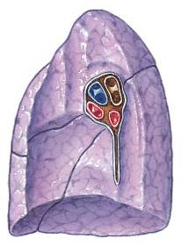
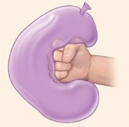
Root of the lung
Consists of structures which attach the lung to structures in the mediastinum (pulmonary artery, veins, bronchus…)
Hilum of a lung
Refers to the entry & exit point of the root structures

Slide 25
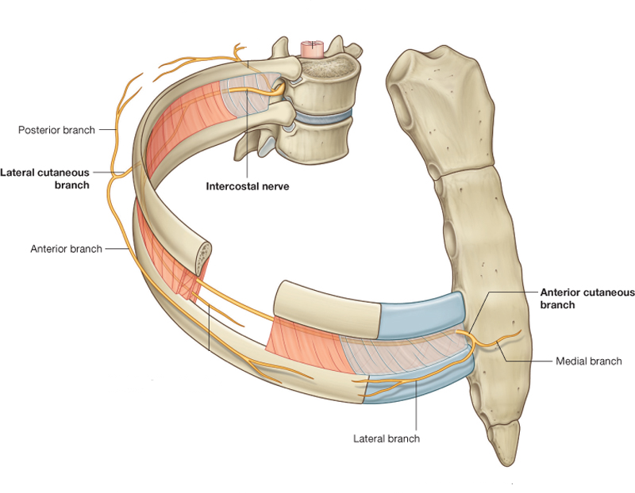
Intercostal Nerves
Innervate the full thickness of the thoracic wall (skin, muscles, ribs & parietal pleura)
Ventral rami of T1 – T11 spinal nerves
The ventral ramus of the T12 spinal nerve is referred to as the subcostal nerve & lies inferior to the twelfth rib
Give off Lateral & Anterior Cutaneous Branches

Slide 26
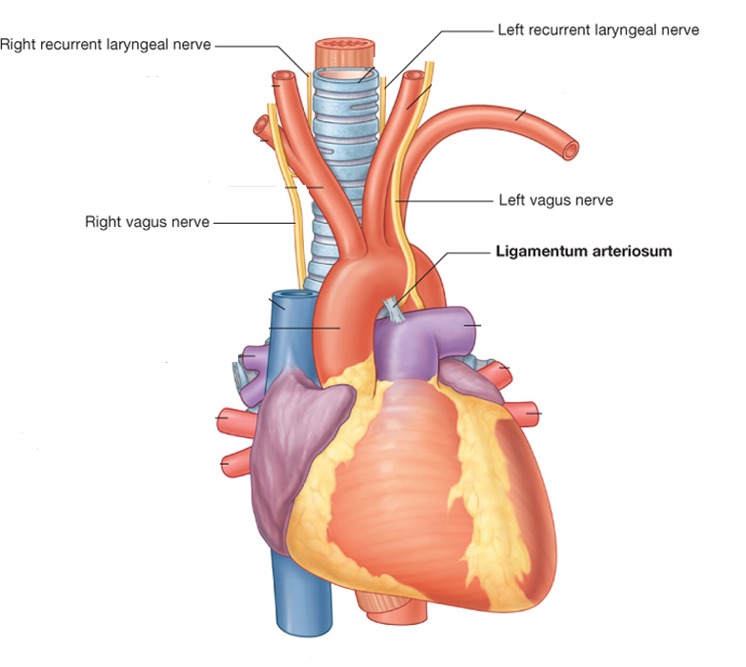
Vagus Nerves
Provide parasympathetic innervation to thoracic and abdominal viscera
Pass posterior to the lung roots
The Left Recurrent Laryngeal Nerve passes inferior to the arch of the aorta and then ascends in a groove between the trachea & esophagus

Slide 27
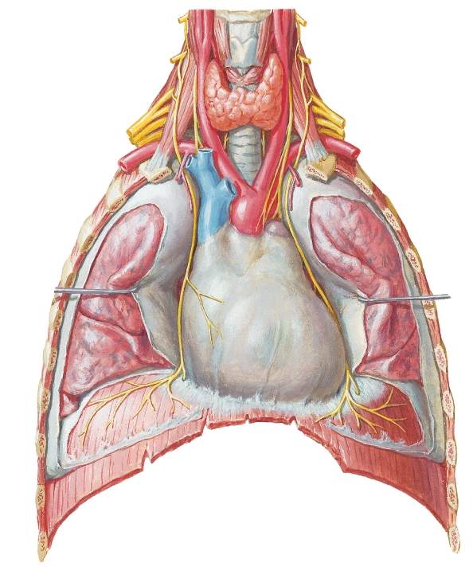
Phrenic Nerves
Pass anterior to the lung roots between the mediastinal pleura and the pericardium
Provide motor & sensory innervation to diaphragm (“C3, 4, & 5 keep the diaphragm alive”)
The phrenic nerves also provide sensory innervation to the mediastinal pleura, fibrous pericardium & parietal pericardium

Slide 28
Questions? Comments? Concerns? Conundrums?
Cody Harrison christopher.Harrison@lmunet.edu Room 143
Stacy Chelf, PhD stacy.chelf@lmunet.edu Room 107

