Slide 1
Neuroanatomy

Slide 2
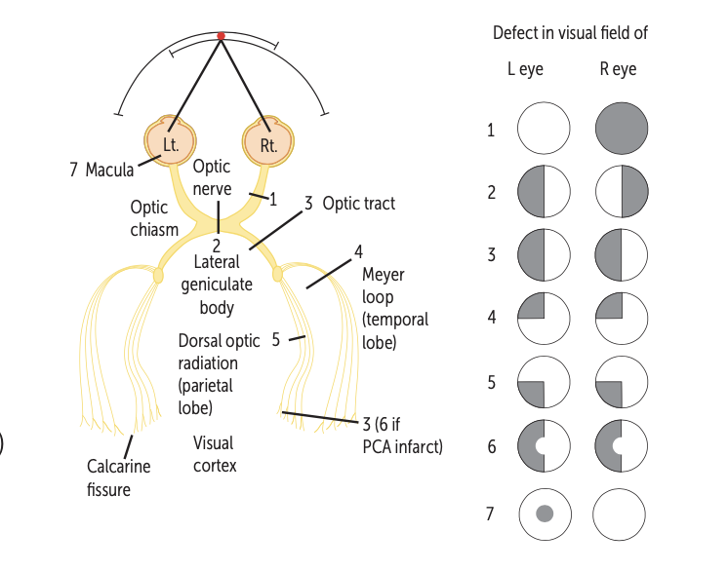
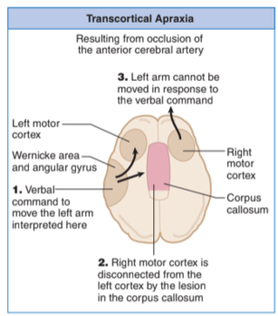
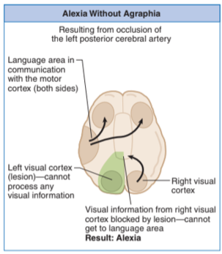
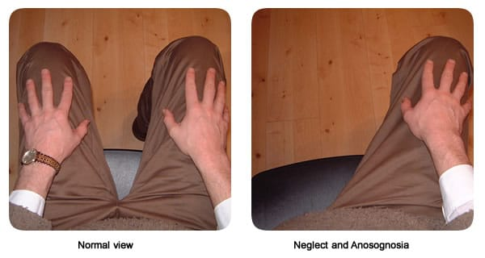
CN II: Optic Nerve
Right anopia
  Ophthalmic A
Bitemporal hemianopsia
  Pituitary tumor (pie in the sky to bitemporal)
  Craniopharyngioma (pie on the floor to bitemporal)
Left homonymous hemianopsia
  Optic nerve problem (one side is MCA rupture)
Left upper quadrantanopia
  “Pie in the sky” – Meyer Lemon pies are the best– in Meyer’s loop and upper quadrantanopia
  Meyer Loop—Lower retina; Loops around inferior horn of Lateral ventricle; temporal lobe
Left lower quadrantanopia
  “Pie on the floor”
  Dorsal optic radiation – superior retina- shortest path via internal capsule; parietal lobe
Left hemianopia with macular sparing
Central scotoma
Goldman perimetry
Circles show what you can see
Example of pituitary adenoma– bitemporal hemianopsia
Neglect Syndrome
Prosody
Patient fails to acknowledge one side of the world -- lesions on the right so patient ignore the left side – hemineglect
Intonation, tone, stress, rhythm of language– “emotional tone” right
Can’t execute command to move left arm
Can’t read, but can write
Notes:
Lecture 25-6: Vision I-II

Slide 3
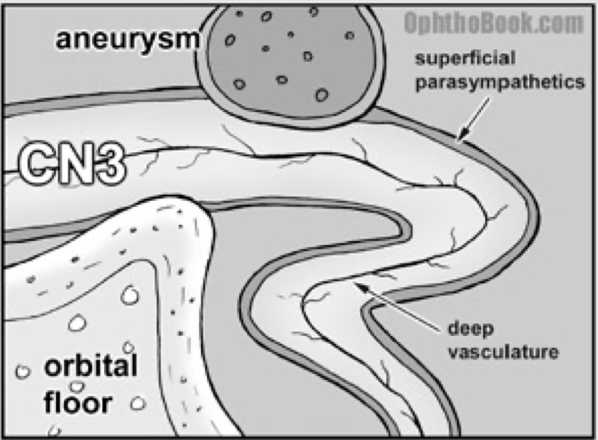
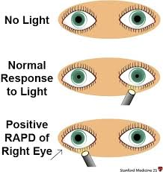



Pupillary light reflex
Accommodation
Third Nerve Compression
Anisocoria = Different pupil size
Pupillary light reflex
  Light travels down optic nerve, chiasm, optic tract before it gets to the cortex
  Some information foes to the pretectal nucleus →posterior commissure → Edinger-Westphal nuclei (EW) → ciliary ganglion and CNIII to eye
  Constriction in ipsilateral eye = direct pupillary light reflex
  Constriction in opposite eye = indirect or consensual light reflex
Reflex produces clear, accurate, binocular vision
  Ciliary muscle contracts to allow the lens to fatten up and increase refractive power
  The eye must converge to report a single image
  The pupil aperture must be small as possible to produce the sharpest image
PNS fibers control pupil constriction run on outside of the nerve
  If pupil is affected, the nerve is being compressed by an aneurysm or tumor
  Ex. Uncal herniation
Vascular lesions occur deep in nerve and don’t affect pupil
  Ex. HTN or DM vascular disease
Argyll-Robertson’s Pupil
Marcus-Gunn Pupil
Cortical Blindness
Known as RAPD (relative afferent pupillary defect)
Swing light in good eye– both pupils constrict to light, swing light in affected eye and both pupils dilate – problem with CN II
Defect om optic nerve (CN II) or retina
Lesion to occipital cortex
  Light reflexes intact
  Eye movement intact
  Can be unilateral or bilateral
  Temporary to permanent
  Blood loss: blockage in posterior cerebral artery
  Preeclampsia, HTN, surgery, CO poisoning, E of cyclosporine
Prostitute’s pupil– indicates 3º syphilis
  Don’t call patient a prostitute if they have this: could be MS, DM neuropathy, alcoholic midbrain degeneration, stroke
Accommodates but does not react to light
Lesion at posterior commissure
Notes:
Lecture 25-6: Vision I-II (con’t)

Slide 4

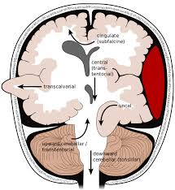
Adie’s Pupil
Uncal Herniation
LY
Anterior Choroidal Syndrome
Tonic dilated pupil
Damage to ciliary ganglion or CN postganglionic fibers
  PNS denervation
At first, pupil is larger “big, slow pupil” but over time becomes smaller “little old ‘Adies’ pupil”
Opposite of Horner’s
Usually result of bacterial or viral infection
Dx: pilocarpine– will constrict Adie’s pupil
Holmes-Adie: affects the eye and ANS with loss of sweating, diminished DTRs
Ipsilateral CNS deficit
Ipsilateral UMN signs (MC) could be contralateral UMN signs – depends on which side of brainstem is compressed
Contralateral homonymous hemianopia
Damages posterior limb– internal capsule plus retro-lenticular portion
  Contralateral Hemiplegia = posterior limb IC
  Contralateral hemisensory deficit
  Contra homonymous Hemianopia (or quadrantopia)
    Retro-lenticular limb IC
    Occurs in the triangular zone of Wernicke
      Where the optic radiations from a triangular area as they endter the IC
For EPC
PERLA = pupils equal round and reactive to light
Notes:
Lecture 25-6: Vision I-II (con’t)

Slide 5
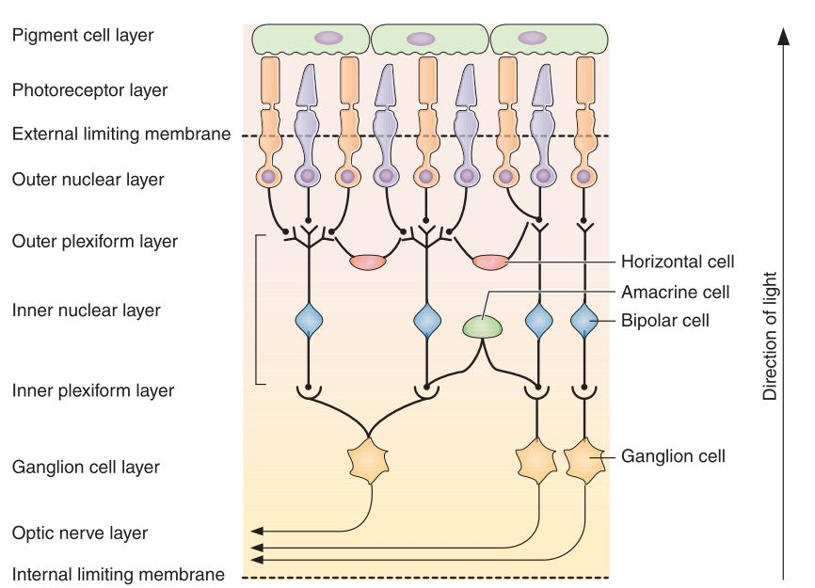
Definitions:
Light → Retina
Retinal dysfunctions:
Light → optic nerve → ganglion cell → bipolar cells (and amacrine cells) → outer plexiform layer where horizontal cells synapse and bipolar cells synapse on photoreceptors → pigment cell layer
Rhodopsin → transducin activated → PDE activated → decreased cGMP → hyperpolarize → decrease Glu
  Inhibitory Glu via MGLUR6 receptors turn ON bipolar cells and ganglion cells → lateral inhibition– edge contrast
  Excitatory → turn OFF bipolar cells
Vitamin A deficiency: permanent vision loss due to retinal deficiency.
Retinitis pigmentosa-: inherited and progressive
  Degeneration of retinal cells.
  Defective opsins may affect rod and/or cone function with loss of night, peripheral, central or color vision, with acuity.
Macular degeneration: leading cause of blindness in the elderly
  Vision loss --central visual field
    severe effects on visual acuity; difficulty reading, and blurry vision that restricts fine work
Retinal detachment
  Loss of vision
    Neural element and the retinal pigment epithelium are separated.
    Areas that have been detached are permanently blind; they do not regenerate.– unless fixed surgically
Diabetic retinopathy
  Retinal damage --microaneurysms (bulged vessel walls) and hemorrhages
  damage retinal cells and cause blindness of the affected regions.
Glaucoma
  damages the retina and optic nerve. The damage is irreversible
  Associated with increased IOP
  d/t increased or decreased outflow of aquous humor produced in ciliary body
Presbyopia: loss of accommodation
Cataracts: cloudy or opaque area in the lens.
Refractive errors can be corrected by lenses, opacity or other problems with the media that cause diffusion (scattering of light) cannot be corrected by lenses.
Visual Acuity is the ability to see fine details. It is determined by the optical quality of the refractive media and by the size of the visual field of the photoreceptors and ganglion cells to which they connect.
Scotoma: a discrete loss of vision or visual acuity in a portion of the visual field
Glaucoma: high IOP compresses axons leaving the retina and may eventually cause death of the neurons. In that case the vision loss is permanent, i.e., it can’t be restored.
The blind spot –ganglion cells gather to form the optic nerve.
Light-Dark Adaptation
Vision impairment
Color blindness
  Reduced ability to perceive color differences
  MC– X-linked recessive
  Complete (monochromacy) rare
  Acquired-- reduces central visual acuity– cones damaged
Blurred vision
  Refractive error– corrected with lens
  Opacity cannot be corrected with lens
    Cataracts MC
Bright light reduces sensitivity– photochemicals must be regenerated before they can respond again to light
  Amount decreases -- causes the photoreceptor to have reduced sensitivity to light
Pupil constricts so less light reaches retina
Miosis-– contraction of pupillary sphincter due to M3 receptors (IP3/DAG) and sympathetic relation of sphincter and contraction of dilator muscle (a1)
Neural adaption: high levels of rhodopsin and dilated pupils
Notes:
Lecture 27: Vision III
MC = most common

Slide 6
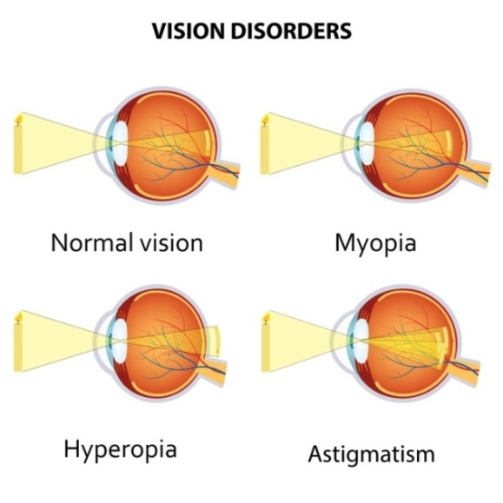
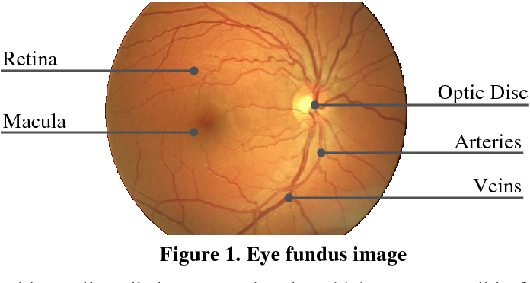
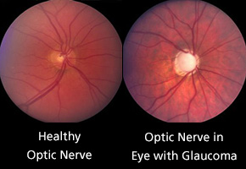
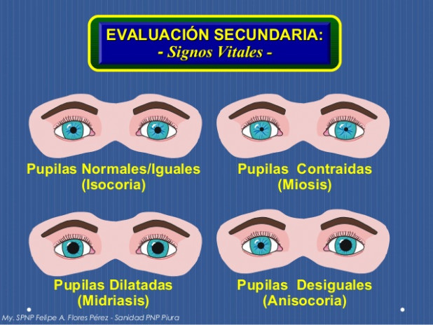
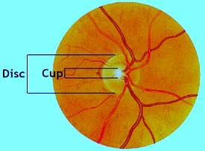
Refractive Error
Strabismus
Emmetropia – focal point is on the retina
Myopia – nearsightedness – focal point in front of the retina, concave (minus) lenses
Hyperopia – farsightedness – focal point behind the retina, convex (plus) lenses
Astigmatism – corneal refracting surface not spherical, cylindrical lenses
Presbyopia – loss of accommodation, bifocal/reading
Amblyopia – lazy eye, occlusion, refractive or strabismic
Nystagmus – short excursion, back and forth
movement, may be fine or course, slow or rapid,
rotational
Heterophoria – misalignment in which fusion keeps the deviation latent (hidden)
Heterotropia – manifest misalignment
Eso- convergent (inward) deviation
Exo- divergent (outward) deviation
Hyper- superior vertical (upward) deviation
Hypo- inferior vertical (downward) deviation
Incyclo- torsional (superior pole tilted medially)
Excyclo- torsional (superior pole tilted temporally)
Pupils
Ophthalmoscopy
Isocoria – equality of size of both pupils
Anisocoria – difference in size between pupils
Miosis – small or constricted pupil
Mydriasis – large or dilated pupil
Fundus Exam:
Notes:
Lecture 28: Eye Exam

Slide 7
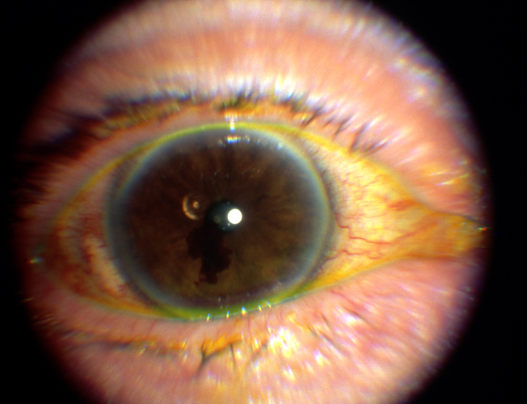
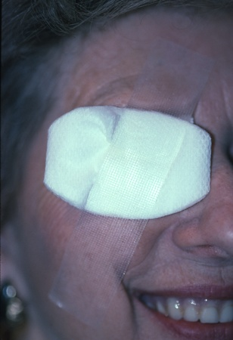
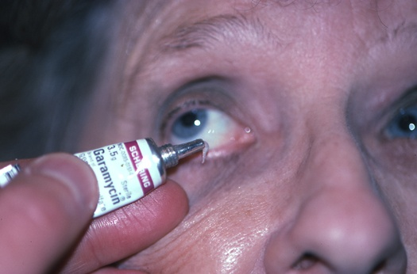
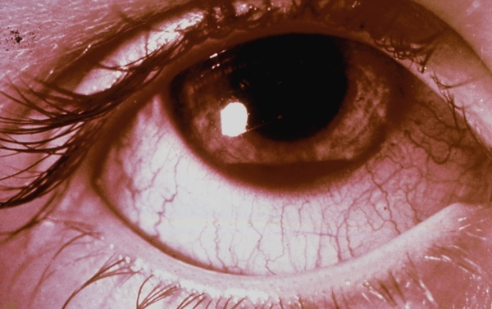
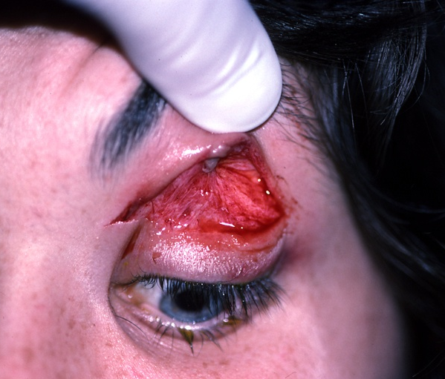
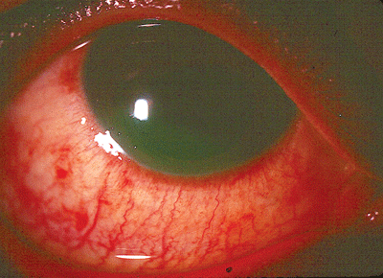

Additional Studies
Foreign Body
Corneal Abrasions
Scleral depression– avoid if hyphemia, open globe, orbital fracture, lid laceration
Ultrasound– intraocular foreign bodies
X-rays
CT scan– readily available, no contrast needed, safe with metal, great for bony fractures
If you notice something is moving, it is in the vitreous
Iritis: inflammation in the anterior aspect of the eye
Small abrasions: no patching
Moderate abrasions: bandage soft contact lens
Large abrasions: pressure patch
Patching Disadvantages:
  Rendered monocular
  Cannot be used in 1 eyed patients
  Cannot be used in contact lens abrasions– pseudo infection
Hyphema
Wounds
Chemical Burn
Orbital blowout:
Sxs: diplopia, orbital emphysema (crepitus with nose blowing), enophthalmos, proptosis, subconjunctival/lid hematoma, infraorbital nerve dysesthesia or anesthesia, NV in trapdoor fracture
Penetrating/Perforating Trauma:
Penetrating– entrance wound only
Perforating– entrance and exit wounds
Laceration– full thickness wound—sharp object
Rupture—full-thickness wound—blunt object
Lamellar—partial-thickness wound
DO NOT test for visual acuity!!!! (only test you don’t need to do first) – WASH EYE
  Lavage with Lactated Ringer
  Sterile Saline
  Tap water or milk
  Morgan lens used in ER
Wait 5-10 minutes after irrigation→ check pH
Irrigate until pH is neutral 7.0-7.4→ URGENT
Acidic burn→ red; better prognosis
Alkalotic burn --> not red
Can develop secondary glaucoma
1/4th rebleed
30% have rise in IOP during acute phase
75% angle recession
Can have corneal blood staining
Notes:
Lecture 29: Ocular Emergencies

Slide 8
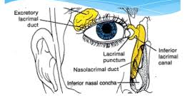
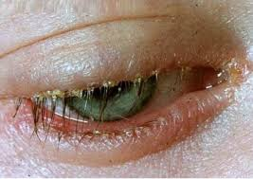
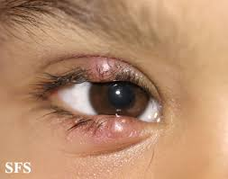
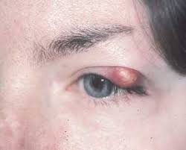
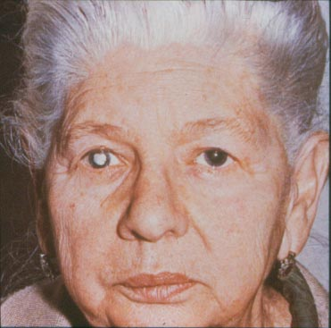
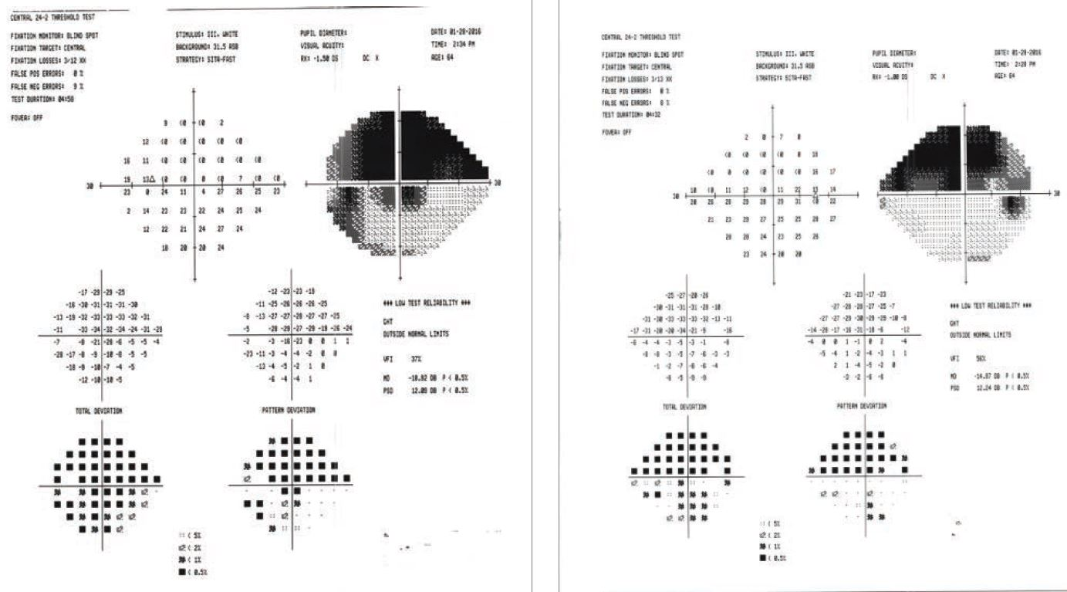
Ptosis
Eye Lid infection
Lacrimal Drainage System
CN III involvement
Levator muscle dehiscence or disinsertion
Sxs: droopy eyelids
Cause: Horner (sympathetics out), CN III palsy, Myasthenia gravis
Blepharitis
Infection of lid margin, lid glands, and cilia follicles
  Sxs: itching, redness, tearing, photophobia, eyelash crusting
Hordeolum
External-infection of meibomian gland– modified sebaceous gland associated with cilia
  Focal pain of lid or lid margin– edematous nodule
Chalazion
Sterile lipogranulomatous inflammation of the meibomian gland-- nontender
Lacrimal gland
Drains superolateral to inferior/medial
Puncta
Canaliculi
Lacrimal Sac
Nasolacrimal Duct
Blepharitis
Hordeolum
Chalazion
Cataracts
Glaucoma
Cause of reversible blindness
Leading cause of low vision
Type of cataract: nuclear, cortical, posterior subscapular
Mature cataract: dense, white, brunescent reddish-brown to black
  Most– normal pupil on light testing
Open Angle
Closed Angle
IOP > 21
No pain, asymptomatic
Increased Cup:Disk ratio
Obstruction of outflow of aqueous humor → increase IOP
IOP 40-90
Severe eye pain, NV, blurred vision
Fixed dilated pupil, injected conjunctiva
Peripheral iris → closely opposed to cornea → decreased aqueous outflow
Pharm review:
ABC’s decrease aqueous production:
A₂ agonists, B-blockers, Carbonic anhydrase inhibitors
Helps with open angle glaucoma
Don’t use muscarinic antagonist and a-blockers
Right eye→ loss of superior vision
*Know how to read these
Notes:
Lecture 30: Anterior Segment

Slide 9
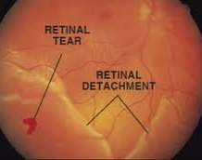
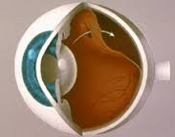
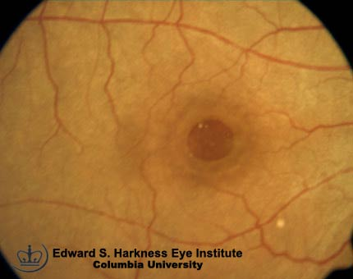
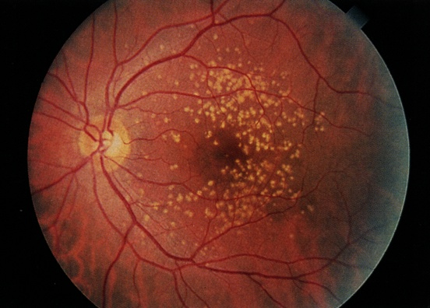
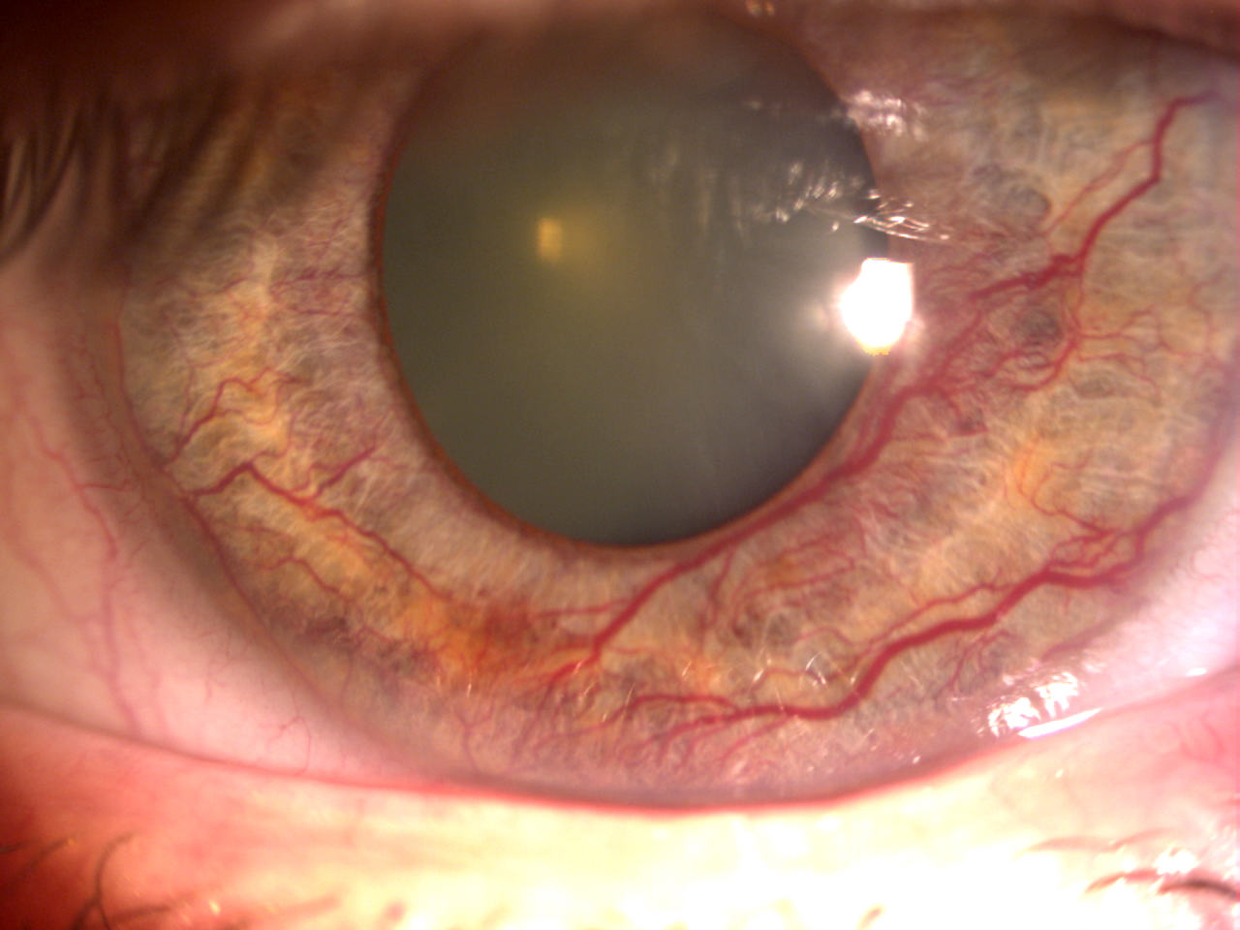
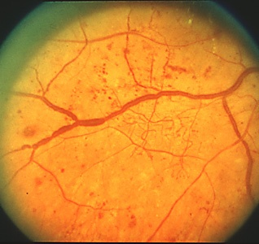
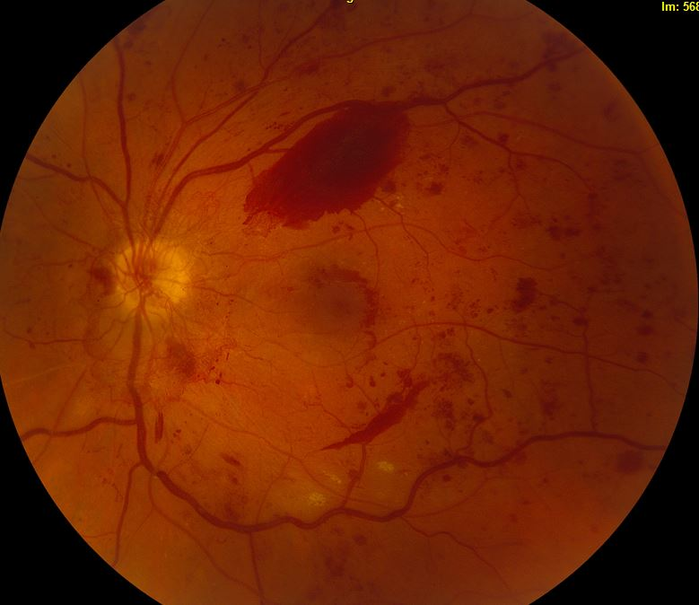
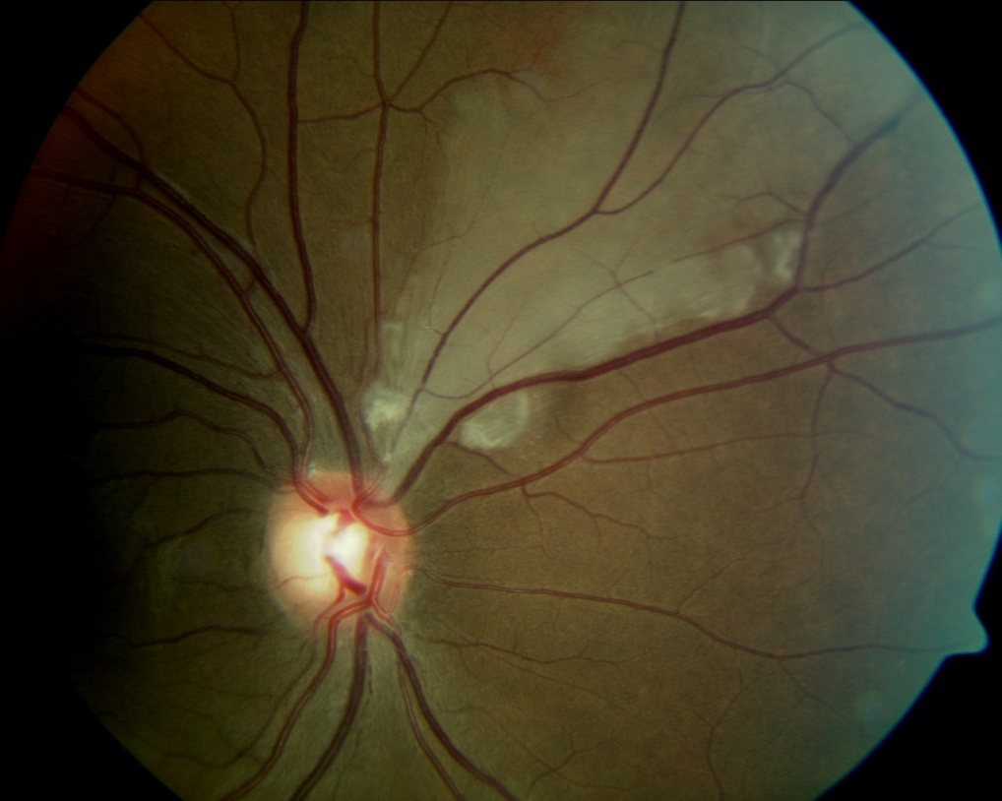
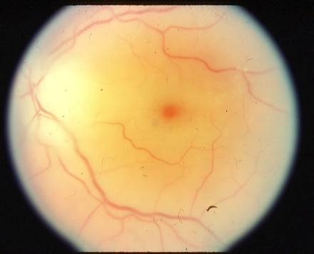
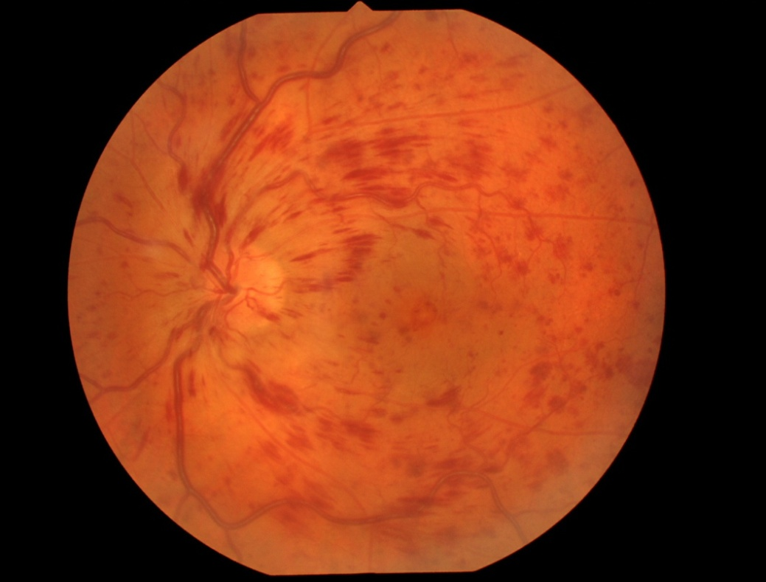
Posterior Vitreous Detachment
Retinal Detachment
Macular Degeneration
Vitreous pulls away from retina: cause--
  Floaters
  Flashes (vitreoretinal traction)
  Hemorrhage
  Retinal Tear
    Vitreoretinal traction usually in a horseshoe pattern
  Macular hole
    Result of foveal attachment plaques
Sudden onset floaters, photopsia, blurred vision, visual field loss, veil or curtain over vision
Full thickness break→ vitreous pass through break in retina
Leading cause of blindness >65
Usually Dry vs Wet
Dry
  Deposition of Drusden – gradual decrease in vision– tx with multivitamin
Wet
  Rapid loss of vision due to bleeding 2º to neovascularization– treat with anti-VEGF
Retinal A/V Occlusion
Diabetic Retinopathy
Ocular Ischemic Syndrome
Non-proliferative:
Sausage-link sign (venous beading)
Cotton wool spots (headed to proliferative)
Proliferative:
Neovascularization
Most are internal carotid artery occlusion
  Risk: smoking, HTN, DM, CVD
Anterior: iritis neovascularization, cataract, iritis, conjunctival injection, corneal edema
Hollenhorst plaque– get carotid artery doppler US
Calcific– get EKG
Amaurosis Fugax→ sudden transient vision loss
Central Retinal artery occlusion
  Cherry red spot with surrounding edema
Branch artery occlusion
  Embolus visible with wedge of retinal edema
Retinal Vein Occlusion
  ”Blood and thunder appearance”
↓
Non-proliferative
Proliferative
→
Central retinal
artery occlusion
Branch retinal
artery occlusion
Retinal
Vein occlusion
Notes:
Lecture 31: Posterior Segment

Slide 10
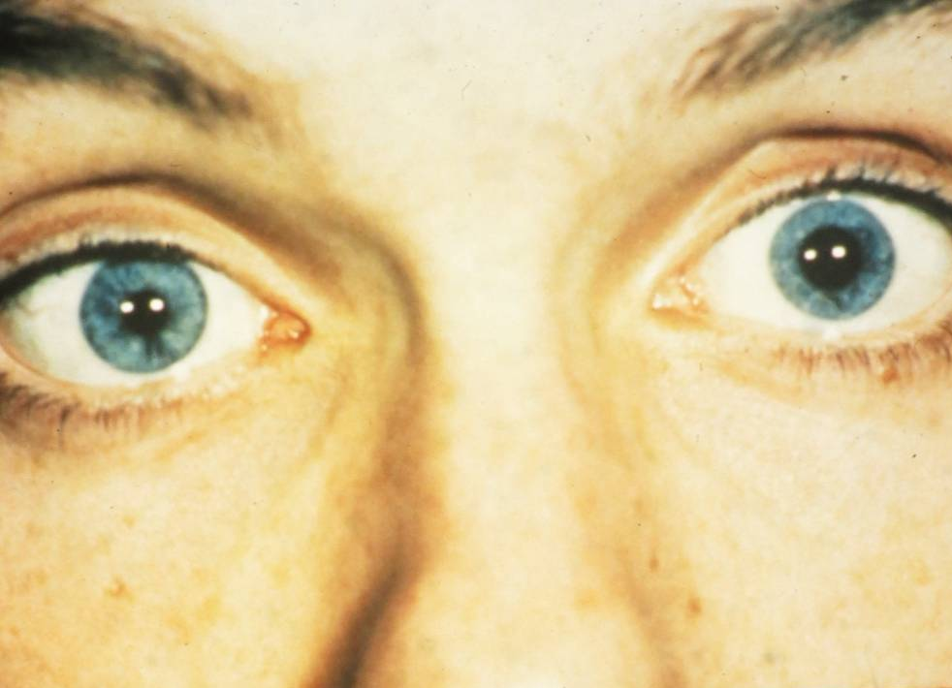
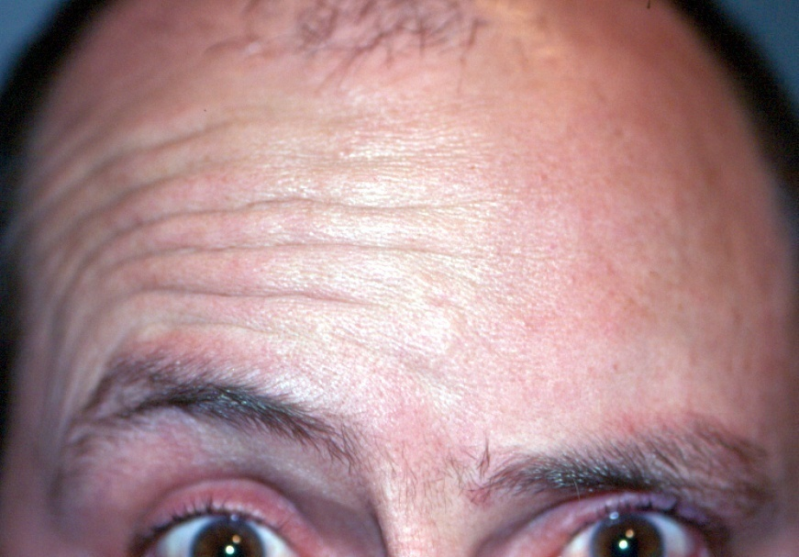
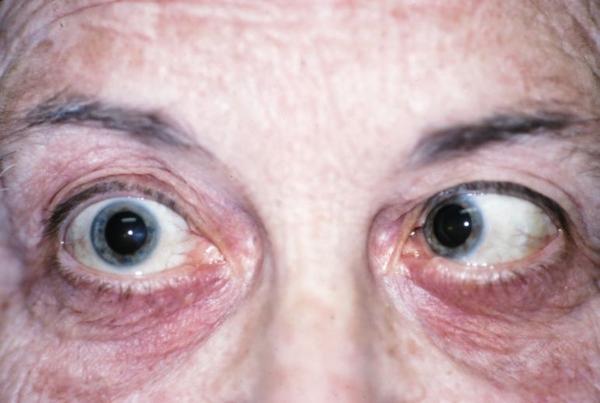
CN II: Optic Nerve
CN III: Oculomotor Nerve
CN V: Trigeminal Nerve
Pupil testing
  Marcus Gunn Pupil: swing light in good eye– both pupils constrict to light, swing light in bad eye and both pupils dilate – problem with CN II
Absolute infranasal altitudinal defect
  Sxs: blurred vision, grey inferior visual problem, high BP, superior sectoral edema, superior nerve fiber swelling
NAION– Non-arteriteric ischemic optic neuropathy
  Acute, unilateral painless vision loss
  Risks: HTN, nocturnal hypotension, hyperlipidemia, DM, sleep apnea, smoking, PDE-5 use
Somatic motor control: SR, IR, MR, IO muscles and levator palpebrae superioris muscle (ptosis)
PNS: ciliary body and iris sphincter
  not working? Mydriasis
Results:
  Hypodeviated, exotropic eye– down and out
  Ptosis, difficulty accommodating
Pupil dilation = emergency
  Benign ischemic infarction– compression from enlarging aneurism at the junction of the carotid and Pcom arteries
Temporal arteritis: new case of diplopia (associated sxs: unilateral headache) – do temporal artery biopsy
  Important to rule out
Anisocoria in light– unequal pupils
CN VI: Abducens's Nerve
CN VII: Facial Nerve
Bell’s Palsy
  Low motor neuron lesion
  Affects one entire side of face
  Ipsilateral to lesion
Stroke– look for UMN signs and other signs besides only unilateral face LMN sign
Right lateral rectus
Temporal arteritis: new case of diplopia
  Sxs: generalized weakness, unintentional weight loss, new onset diffuse H/A (usually unilateral)
  Hx: well controlled HTN
  CBC: mild anemia
  Sed Rate (ESR) >20 (elevated)
  CRP (inflammatory marker): positive
  Temporal artery biopsy: positive
  Important to rule out
Notes:
Lecture 32-3: Neuro-Opthalmology

Slide 11
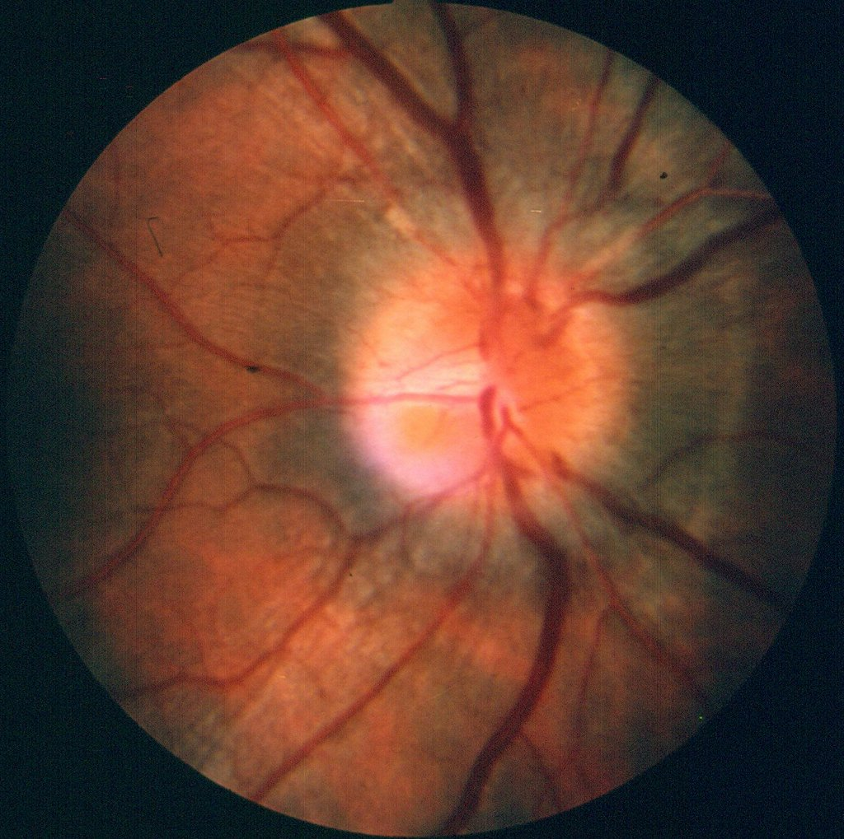
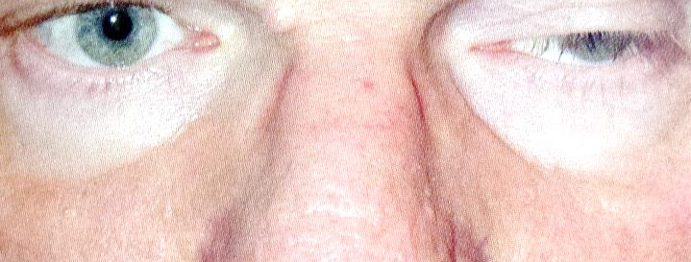

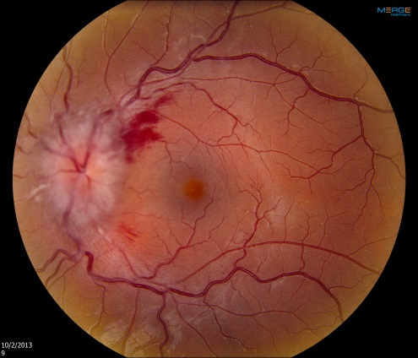

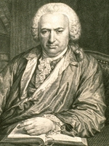

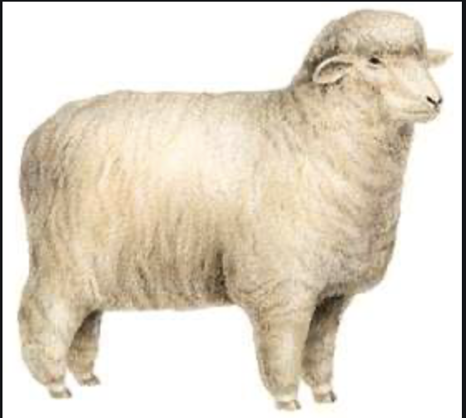
Myasthenia Gravis
Optic Neuritis
Sxs:
  Bilateral, asymmetric
  Ptosis
  Diplopia– no pupil involvement
Worse at end of the day
Tests to order:
  Ice test– relieves ptosis
  Fatigue test
  Edrophonium
  Serum—Ach receptor AB
Sxs:
  Acute vision loss that peaks at 1-2 weeks (usually monocular)
  Eye pain with movement
Afferent pupillary defect with visual field defect
Associated with: MS
Pseudotumor Cerebri
Charles Bonnet Syndrome
Usually in young, obese females
Sxs: HA, transient visual obscurations, diplopia (CN VI palsy), papilledema, elevated ICP, tinnitus
Dx: MRI with contrast, LP– elevated ICP (above 200) with normal CSF composition
Older age: 75-80yo
Impaired vision 20/60 or worse in better eye – usually macular degeneration
”Fictions in vision”– images recurrent and complex
Episodes: days to years and variable in frequency– non-frightening, pleasant images
Non-psychiatric related episodes
Pt has reluctance to disclose they are “seeing things”
  Usually enjoys their visions– gives them company
Notes:
Lecture 32-3: Neuro-Opthalmology (con’t)

Slide 12
Nucleus | Symptom/Function | Destruction | Mnemonic
Preoptic nucleus | Thermoregulation and sexual behavior, releases GnRH |  | Shallow people only see (optic) sexual characteristics first (pre)
Lateral Nucleus | Hunger | Anorexia, fails to thrive | Lateral makes you Lean
Supraoptic and paraventricular nuclei | Synthesize ADH and oxytocin |  | Pee up (supra) to your eyeballs (optic)
Anterior Nucleus | Cooling, PNS |  | A/C= Anterior Cooling
Suprachiasmatic nucleus | Circadian rhythm |  | Sun-Censing Nucleus
Ventromedial nucleus | Satiety | Hyperphagia | VentroMedial makes you Very Massive
Dorsal Medial Nucleus | GI motility |  | DM is close to BM– get a bowel movement from GI moving
Periventricular Nucleus | Fear and Escape behavior |  | Peri is Scary so I must escape
Arcuate Nucleus | Repro and Dopamine |  | Playing in the Arcade is Dope
Mammillary Nuclei | Limbic mechanisms in memory function |  | Mammillary--Memory
Posterior Nucleus | Heating, SNS |  | Hot Pot
Preoptic
Anterior
Middle
Posterior
Notes:
Lecture 34: Hypothalamus
Note: not the best lecture– so I majorly summarized for this one (usually don’t) and used mnemonics– I don’t think the questions he asked were terrible
I stole the Mnemonics from First Aid –mostly
The paths aren’t on here but they are named from where they come from and where they go

Slide 13
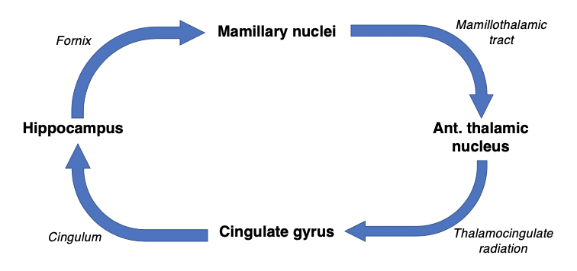
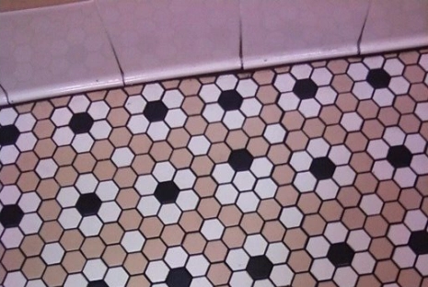
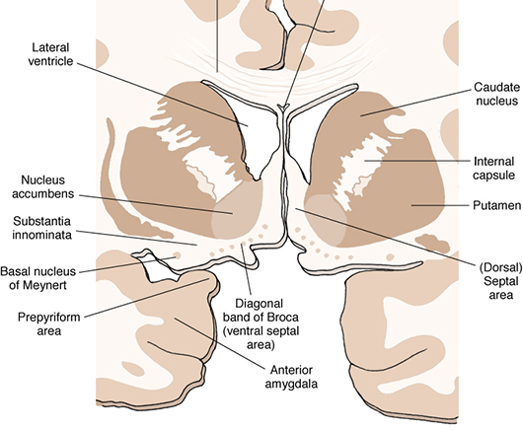
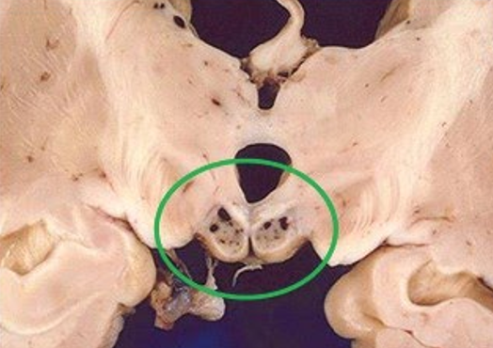
Limbic Function
Limbic Lobe
Papez circuit
Five F’s: Feeding, Fleeing, Fighting, Fleeing, Sex
Limbic lobe + functionally related CNS structures
Cinglulate gyrus (CINGy), Septal area (paraterminal gyrus and subcallosal area), Parahippocampal gyrus
Fornix is suspended in the septum pelucidum and ends anteromedially as the mamillary body and splits, going posterolateral as the hippocampus
Functions to consolidate memory and learning by transferring short term memory to long term memory.
The hippocampus emits signals that rapidly reverberate through the circuit, and are then stored permanently in areas of the cerebral cortex for long-term memory.
Hippocampus makes up the floor of the temporal lobe and the lateral ventricle
Most susceptible to hypoxia
Alzheimer’s Disease
Wernicke’s Encephalopathy
OCD
Progressive dementia in individuals <65yo
Patients are forgetful and develop progressive abnormalities of memory and cognition
Low Ach innervation of cerebral cortex
  Degeneration of the basal nucleus of Meynert in substantia innominate
Degeneration of neurons of neurons in entorhinal cortex and the subiculum of the hippocampus
Entorhinal cortex is the gateway to the hippocampus
Caused by thiamine (B1) deficiency – frequently exacerbated by alcohol abuse
Wernicke's encephalopathy is characterized by triad of signs: ataxia, ophthalmoplegia, confusion
Wernicke’s encephalopathy can be treated by thiamine supplementation
If not treated→ Korsakoff syndrome
  Characterized by damage to the components of Papez circuit, including the mamillary bodies, anterior thalamic nucleus, dorsomedial thalamic nucleus, and cingulate gyrus
  Sxs: anterograde amnesia, retrograde amnesia, confabulation, apathy
Pattern of unreasonable thoughts and fears (obsessions) that lead you to do repetitive behaviors (compulsions)
Examples: fear of being contaminated by touching objects other have touched
Cingulate gyrus has been implicated
Notes:
Lecture 35: Limbic System

Slide 14
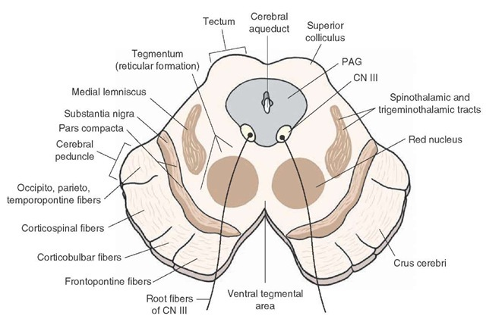
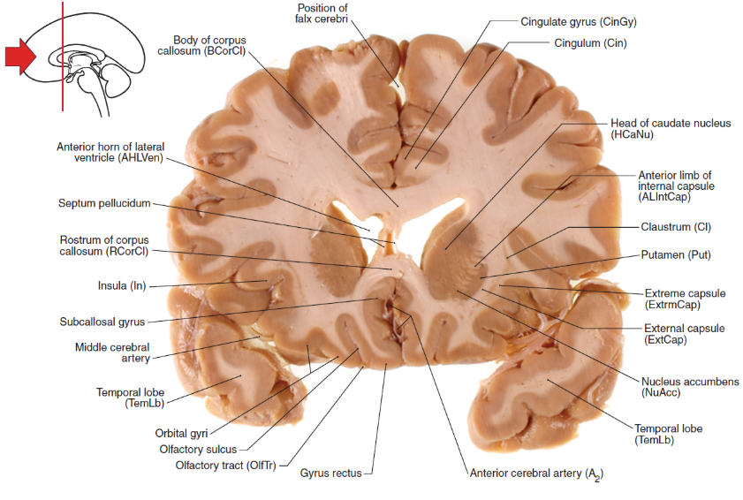
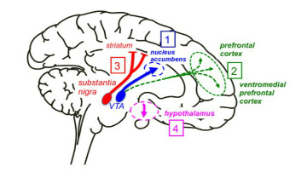



Dopaminergic Pathways
VTA
Nucleus accumbens
Major pathways:
  Mesolimbic: reward pathway VTA → nucleus accumbus
  Mesocortical: VTA → pre-frontal cortex
  Nigrostriatal: SNc --. Caudate/putamen
  Tuberoinfundibular: Hypothalamus → pituitary gland
Between red nucleus and CNIII
Associated in: reward center, sexual pleasure, addiction, motivation
Excess dopamine to NuACC is responsible for drug-related reinforcement behaviors
Excess DA also associated with schizophrenia
Mesolimbic pathway
Amygdala
Klüver-Bucy Syndrome
Drives motivation for: thirst, hunger, sex
Lesion: no longer seek reward
Associate experiences with consequences and program appropriate experiences
Associated with fear-inducing/threatening stimuli, and initiating a “fight or flight response
Bilateral destruction of the amygdala
  Sxs: Absence of fear response, Hypersexuality, Overly attentive to all sensory stimuli (put things in mouth), Docile
Kinda like how Gary Busey acts
Notes:
Lecture 35: Limbic System (con’t)

Slide 15


Monoamine Theory
MAO
Depression is the result of too little
monoamines (5HT, NE)
NE: The most prominent cluster of NA-neurons is the locus ceruleus (LC)
  The axons running in the discrete medial forebrain bundle (MFB)
  Mnemonic: ‘Bear! Ah (NE release)-–You “ceruleus”?’
Serotonin = Doral Raphe nucleus
NE = Locus ceruleus
NE and 5HT normally destroyed by the enzyme MAO.
MAO inhibitors block this enzyme, inhibiting the destruction of NE and 5HT allowing the transmitters to remain active longer.
Ex. Reserpine
  First used as antihypertensive. It was also noted that it led to depression.
Ex. Iproniazid
  First given to patients with TB. Noticed that it calmed them down. Not used due to hepatitis.
Ex. Imipramine
  antihistamine but was unsuccessful. Its energizing effect tried on depressed patients
Mesolimbic
Typical Antipsychotics
Atypical Antipsychotics
Drugs that increase dopamine can cause psychosis i.e. Amphetamine, cocaine.
Drugs that decrease dopamine will decrease psychotic symptoms.
Antipsychotic drugs block dopamine receptors.
These drugs work on this pathway (Mesolimbic)
Efficacy: block DA activity in mesolimbic
SE: block DA in nigrostriatal
Therapeutic effect of blocking hyperactive DA neurons in mesolimbic pathway
However blocking the other three pathways (nigrostriatal) is harmful.
Serotonin-Dopamine Antagonists
Low extrapyramidal symptoms
Block D2 and Serotonin 2A
  When serotonin is released it binds to the 2A receptor and inhibits dopamine release. 5HT-2A receptors act as a brake on dopamine release.
Block DA in the bad pathways (mesolimbic ) but increase it in the good pathways (nigrostriatal) – overcome dilemma
Schizophrenia
Parkinson meds
Dopamine
Parkinson’s
Schizophrenia meds
Notes:
Lecture 36: Chemical Neuroanatomy

Slide 16


Long-Tern Potentiation (LTP)
Non-NMDA Receptor (AMPA)
Long lasting changes in the efficacy of the synapse
  Turn up volume on neural firing
Associative: weak input can be strengthened if paired with a strong input
  Why mnemonics help
Input specificity: inputs that are not active at the same time doe not share in strengthening (use it or lose it)
If we only fire neuron “bell” then small amount of glutamate is released and only small amount of non-NMDA receptors are occupied
  Only Na⁺ enters cell
NMDA Receptor
Cerebral Layers
More firing “bell + food” allows Glu to occupy all Non-NMDA receptors → voltage change and NMDA receptor can open
  Ca²⁺ enters cells
Layer 5
  Output layer
  Things that leave the cortex leave here (CST)
Layer 4
  The input layer (thalamocortical input)
Blocking NO blocks cell death
EDRF releases NO
Cortical neurons
Neuro-degeneration
24 Hr
Glu
Why we use Mg²⁺ in acute stroke → Too much Glutamate
  Causes glutamate excitotoxicity → Too much Ca²⁺ → neurotoxicity
Notes:
Lecture 37: Learning and Memory

Slide 17
CT Head
MRI Head
MC ordered exam to assess head pathology
1st line workup for clinical scenarios
  Advantages: Quick, Available, Cheap (-er than MRI), superior special resolution, great for fractures
  Disadvantages: ionizing radiation, poor evaluation of the posterior fossa
Used to evaluate intercranial hemorrhage → should be obtained immediately upon presentation to the hospital (w/I 45 minutes)
  If negative → can administer TPA for those you suspect have ischemic stroke
Epidural- Biconvex shape, do not cross sutures or dural reflections
Subdural- Crescent shaped, may cross sutures
Subarachnoid- Typically layer within cortical sulci
Intraparenchymal- between the parenchyma
Uses very strong magnetic field
Advantages: no ionizing radiation, greater soft tissue contrast, superior evaluation for acute ischemic stroke, white matter disease, tumors, and many other disease processes
Disadvantages: much longer acquisition time (about 45 minutes) and subsequent difficulties imaging patients with altered mental status or severe claustrophobia , unable to image patients with metal in them, decreased special resolution, expensive
T2 CSF is bright
MRI is more sensitive and specific in the setting of acute ischemic stroke – diffusion weighted imaging is best sequence to evaluate
Angiography
Spine
Used for vascular evaluation
CTA uses radiation and IV contrast-– superior spatial resolution
MRA – with or without contrast – inferior spatial resolution and susceptible to flow artifacts
CT
  Most useful in acute trauma
  Obtained in other settings to those individuals who cannot undergo MRI
  Very limited in setting of chronic pain/radiculopathy
  First line due to availability and cost
MRI
  Much better evaluation of soft tissue and spinal canal contents
  Best for radiculopathy and nerve impingement
  Superior in evaluation of non-traumatic abnormalities such as infection of metastatic disease
Notes:
Lecture 38: Neuroradiology
Know the advantages/disadvantages

